Slide 1
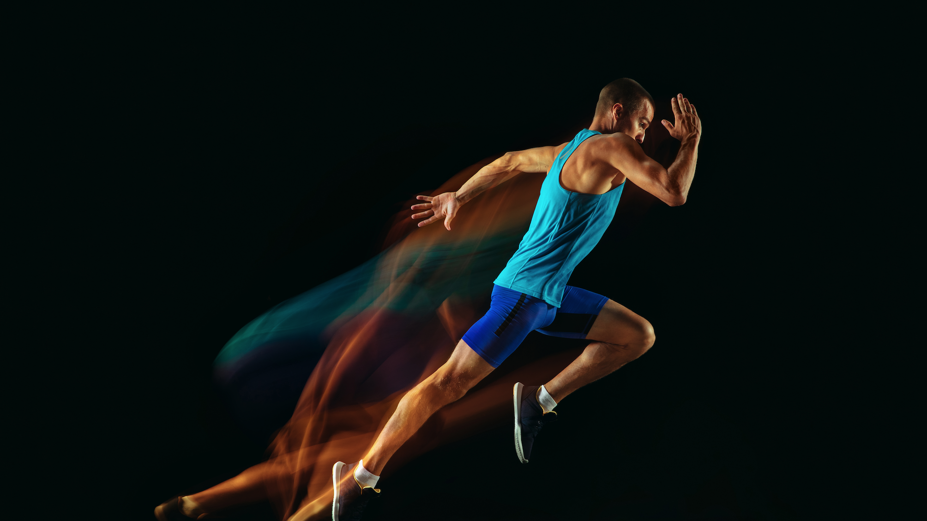
Understanding Motion
Notes:
Understanding motion is a foundation of physics as well as chemistry and biology. The universe and everything in it is in constant motion. In this activity, we will establish the foundations of understanding motion by measuring displacement as a function of time.
The measured top speed of the world’s fastest runner, Usain Bolt, is 12.3 m/s.
While conventional physics labs might use a tape measure and a stopwatch to introduce motion, this activity will use the exceptionally powerful Global Positioning System (GPS). Almost everyone currently uses the GPS routinely in their daily lives. This lesson introduces students to the physics behind GPS, the global coordinate system of latitude and longitude and the use of spreadsheets for analysis and graphing of data, while teaching the foundations of motion (displacement and velocity).
There will be opportunities for students to solidify their understanding of vector and scalar quantities in this lab. It is expected that the concepts of vector and scalar quantities will be introduced in lecture material prior to the laboratory activities.

Slide 2
Understanding Motion
Unifying Concepts
Lesson Components
Applications:
Making it Real
Relationships:
Displacement, Distance
Velocity, Speed
Vectors, Scalers
Measuring Latitude and Longitude
Measuring
Velocity and Speed
Solar System
Significant Figures
Rate of Change
Continental Drift
Understanding patterns and scales of motion
Scalars and Vectors
Determination of best fit lines and determination of slopes from graphs
Communications
Graphing and
Analyzing Data
Navigation
The laws of physics are observed all around us.
Measuring Displacement and Distance
Wildlife Telemetry
Test Systems
Systems and Models
Global coordinate system
Motion is relative to your coordinate system
Global positioning system
Understanding global coordinate systems
Walking
Tracking People Movement
Running
Calculations with spreadsheets
Driving
Notes:
This chart provides an outline of the unifying concepts, lesson components and applications that will be covered in this set of activities.
Much of this unit will focus on using a very simple experimental design to measure the coefficient of kinetic and static friction. In the process, the activity provides for a very rich investigation into the core disciplinary ideas in mechanics.

Slide 3
Understanding Motion - Unit Overview
Unifying Concepts
Experiments
Applications and extensions
  Kinematic relationships
  - Displacement
  - Distance
  - Velocity
  - Speed
  Understanding patterns and scales of motion
  Laws of physics are observed all around us
  Systems models
  - Global coordinate system
  - Motion is relative to your coordinate system
  - Global positioning system
  Experiment 1: Measuring position in latitude and longitude using GPS.
  Experiment 2: Plotting data using spreadsheets
  Experiment 3: Calculating displacement and distance
  Experiment 4: Calculating velocity and speed
  Experiment 5: Running: displacement, distance, velocity and speed
  Experiment 6: Driving along lines of latitude and longitude
  Experiment 7: Motion in two dimensions.
  Solar System
  Continental Drive
  Communications
  Navigation
  Wildlife telemetry
  Tracking people movement
Notes:
This table provides an alternative view of the graphical chart on the previous page. It outlines the unifying concepts, experiments and applications that will be covered in this set of activities.
Much of this unit will focus on using a very simple experimental design to measure the coefficient of kinetic and static friction. In the process, the activity provides for a very rich investigation into the core disciplinary ideas in mechanics.

Slide 4
Motion
Everything in the universe is in constant motion.

Slide 5
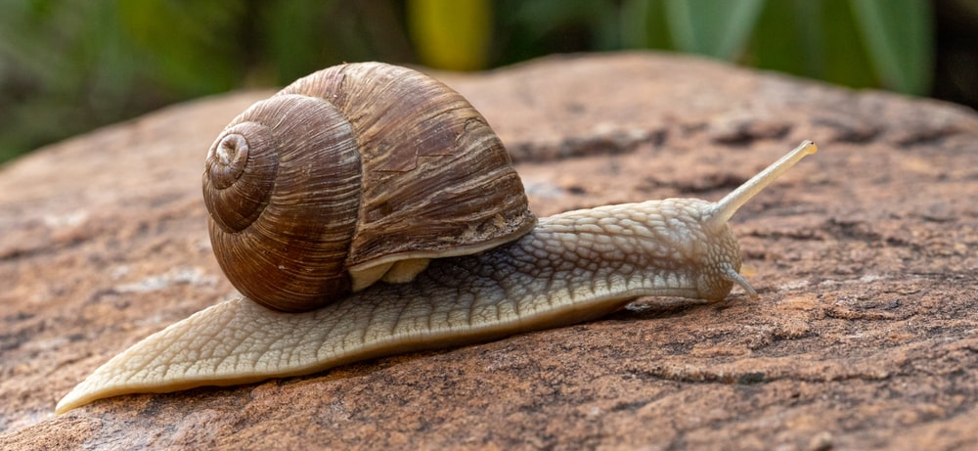
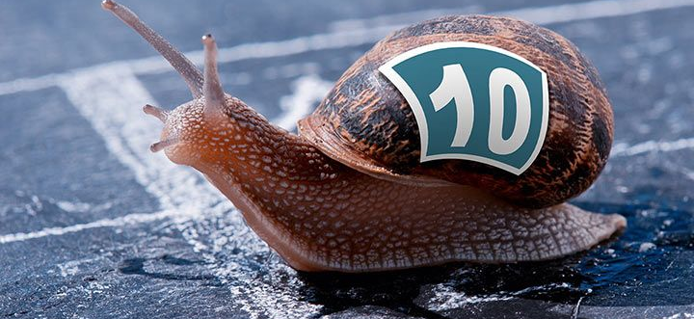
How Fast is the Snail Moving?
Notes:
Speeds of ~0.002 m/s have been observed at the Snail Racing World Championships.

Slide 6
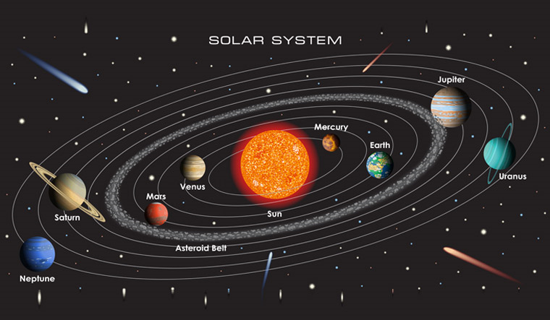
The Earth moves around the Sun at:
67,000 miles/hour or 30,000 m/s
Notes:
In physics we will learn about the forces in a solar system that result in planetary motion in very well predicted orbits.

Slide 7


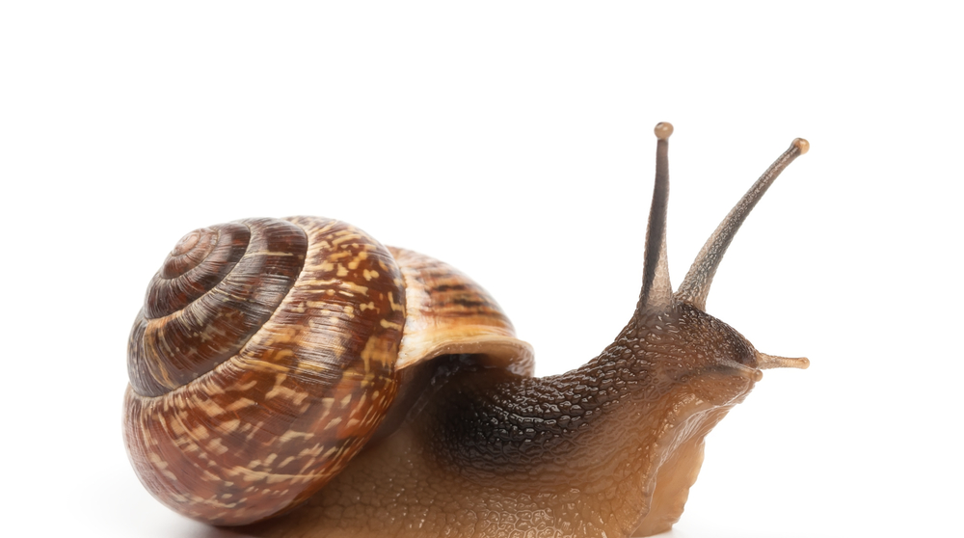
A Snail on Earth Moves at 30,000 m/s relative to the Sun
Motion is Relative and the Measurement of Speed Depends on the Reference Coordinate System
Notes:
In describing physical systems, it will always be important to understand the frame of reference for measurements. In this case, the snail is either moving very slow or extremely fast depending on your frame of reference.

Slide 8
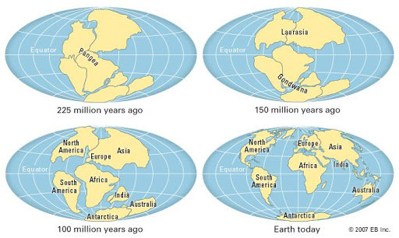
Continents “Drift” at Very Slow Velocities (2.5 cm/year) but Can Move Long Distances over Millions of Years
Notes:
The North American and Eurasian tectonic plates are separated by the Mid-Atlantic Ridge. The two continents are moving away from each other at the rate of about 2.5 centimeters per year.

Slide 9
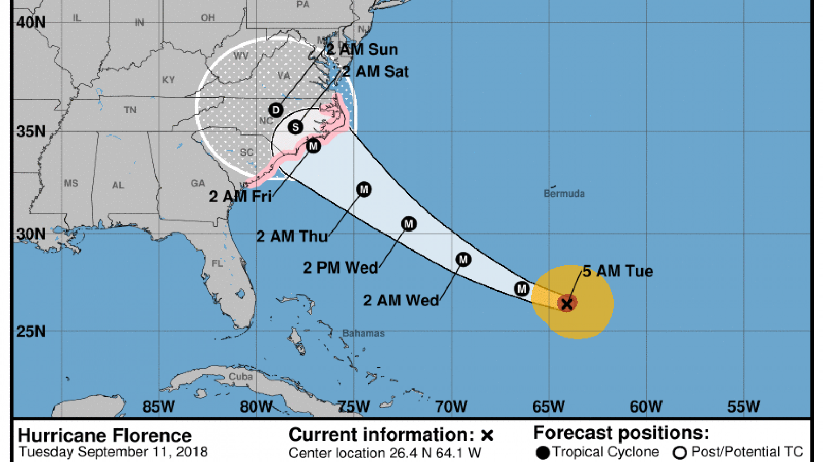
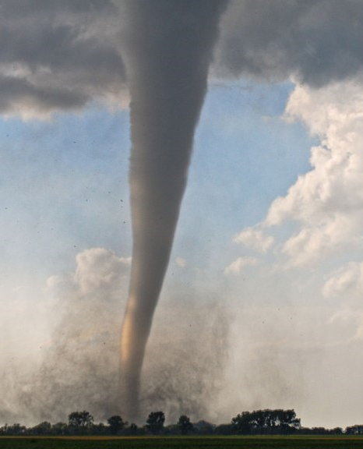
Storms Systems often Move Slowly but the Wind Velocity within a Hurricane or Tornado can Result in Significant Devastation
Notes:
Wind speeds in tornados have been measured to exceed 300 mph (~130 m/s).
Hurricane generally have lower wind speeds than tornados but last for sustained periods of time over large geographic areas.

Slide 10
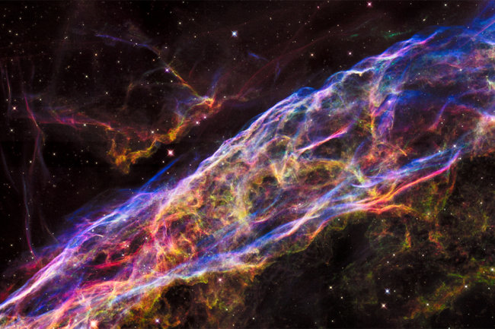
Light can Travel Extremely Long Distances at High Velocities.
Notes:
Light travels at ~300,000,000 m/s allowing us to “look back in time” at very distance objects and better understand the origins of the universe. In physics, we will also learn how we take advantage of the speed of light (and other forms of electromagnetic radiation) to enable communications and transfer large amounts of data over long distances.

Slide 11

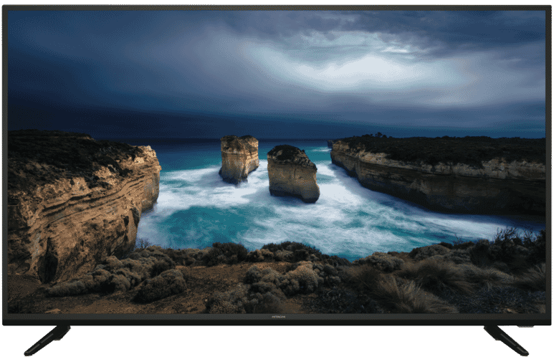

Electromagnetic waves travel close to the speed of light in electrical circuits.
The drift velocity of electrons in a circuit is about the speed of a snail.
Notes:
The rapid movement of charge and the propagation of electromagnetic waves in electronic devices is essential to modern electronics. In studying physics, students will learn about the movement of charge and the role it plays in their lives.

Slide 12

The average speed of helium atoms at 25° is 1255 m/s
Notes:
Molecules move at relatively fast speeds compared to macroscopic objects such as people, cars and balloons. In physics we will learn how the motion of molecules in gases, liquids and solids impacts the properties of matter.

Slide 13
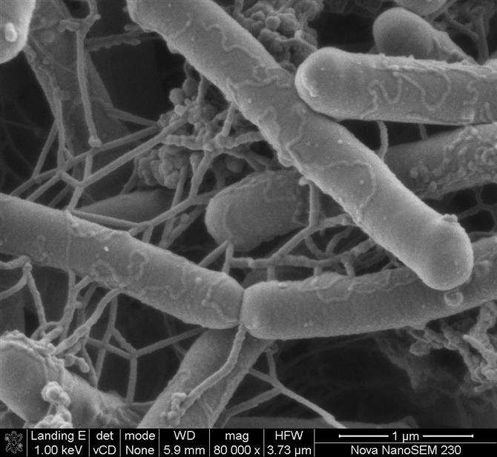


Salmonella Bacteria Move Slowly Over Short Distances
Notes:
Many bacteria are able transport themselves in their microscope environments. The ability of microbes to move on their own or be transported by external forces is critical to their function and survival.
An interesting fact: CDC estimates that Salmonella bacteria cause more than 1.2 million illnesses each year in the United States, resulting in more than 23,000 hospitalizations and 450 deaths.

Slide 14
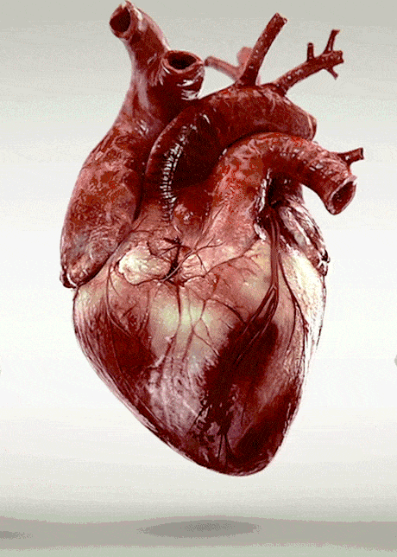
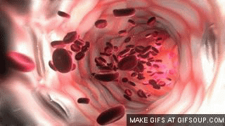
Life Depends on Motion Over a Wide Range of Scales
Notes:
Movement of the tissues and fluids in are body are essential for life. Computational modeling of movement of the heart and blood flow can be used to guide cardiovascular surgeries in order to improve patient care.
In general, the movement of fluids is a major subject of study, “Fluid Dynamics”. This is not just important for our bodies but also for understanding the movement of vehicles, the processes in combustion engines, movement of fluids in chemical plants and the flow of water around the world. Students could be asked to name many more examples.

Slide 15

Notes:
Motion control is big business with an expected market of $25B by 2025. There will be increasing opportunities for mechanical and electrical engineers to continue to advance motion systems, which include robotics and control of autonomous vehicles.

Slide 16
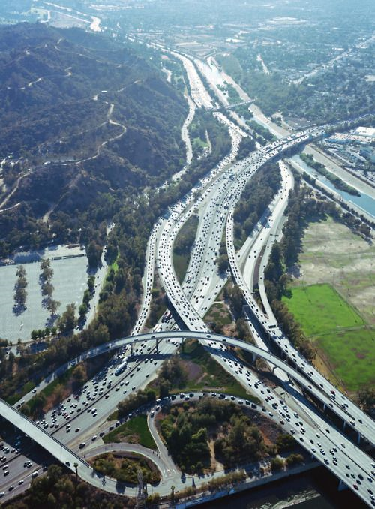
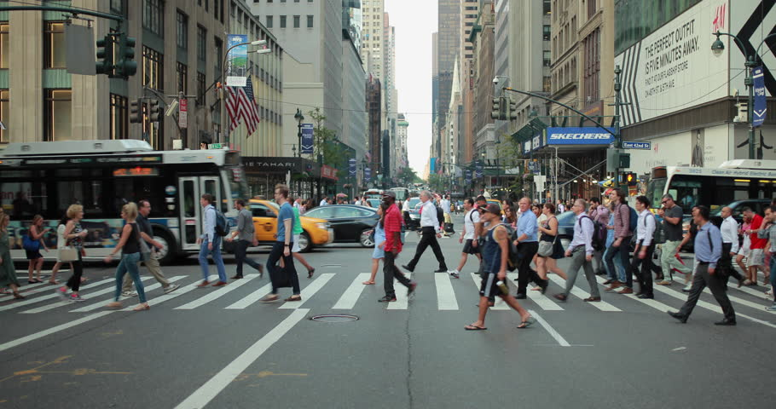
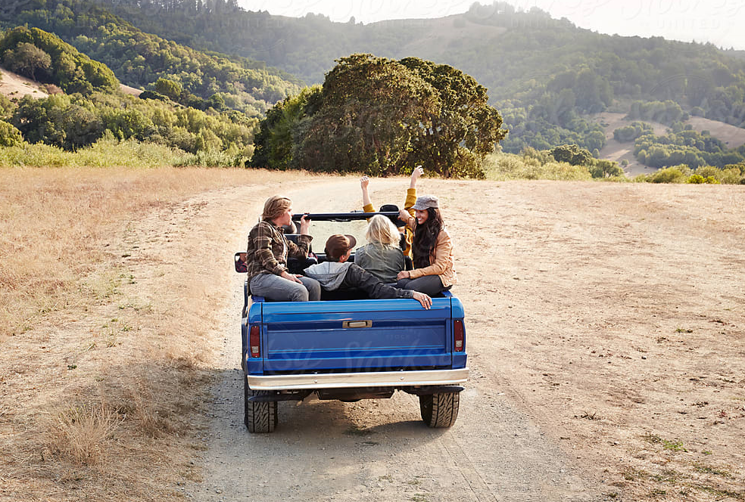
People moving from place to place
Notes:
We are very dependent on understanding how long it takes to get from place to place. In order to answer that question, we start with understanding distances and how quickly we can move.

Slide 17
Understanding Motion is Critical for a Wide Range of Scientific and Engineering Disciplines
In this activity we will explore motion by examining the displacement and velocity of people/objects as they travel short distances across the surface of the Earth. As we do this, we will also learn about geographic coordinates and how satellite-based location systems, like GPS, work.
Notes:
The use of GPS to measure motion allows an opportunity to introduce to students a very powerful technological advance that is filled with great examples of the core physics principles. These principles will be explored in the coming year of an introductory physics course. This set of activities begins with an introduction to the fundamental concepts of displacement and velocity.
A simple alternative experiment to measure displacement vs time using the lap timer on a phone and cones spaced at a known spacing is included at the very end of this lesson.

Slide 18

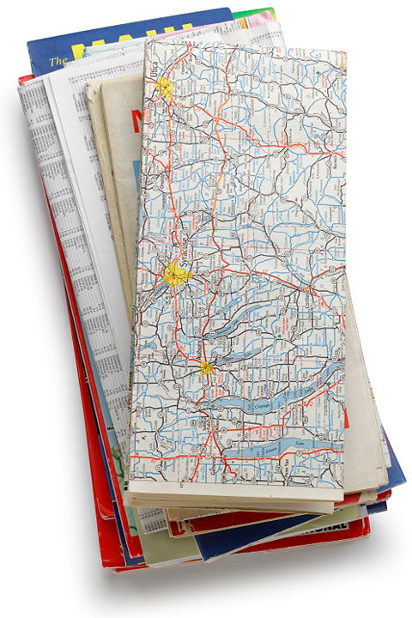

How do I get from New York City to Disneyland? How long will it take me?
In 2004
Notes:
Prior to 2005, people typically used paper maps to determine distances and determine routes of travel.
The teacher might ask students if they have every used a paper map. Students may have used maps on hiking trails, the zoo or amusement parks but few have used maps to travel by car, which is a relatively recent change that occurred during their lifetimes.

Slide 19
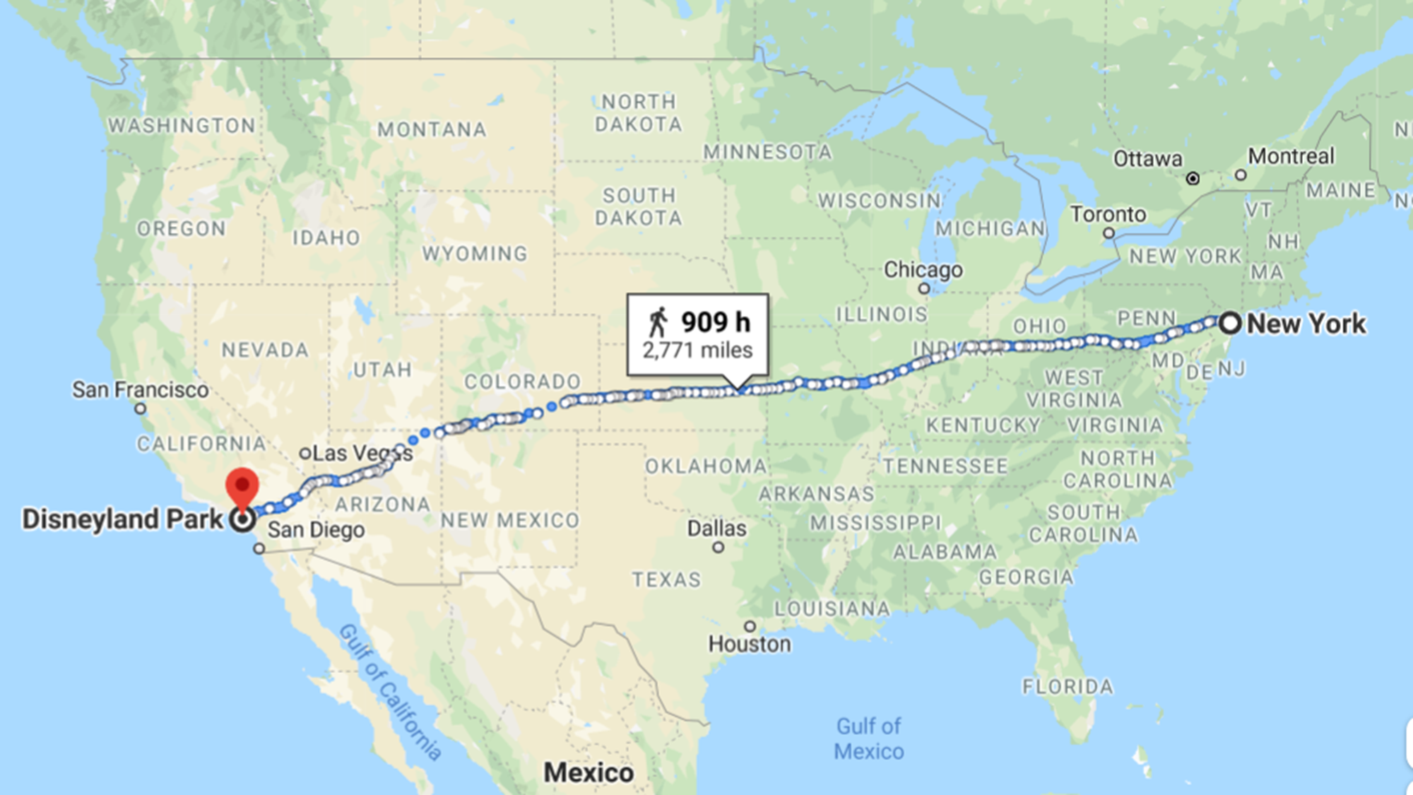
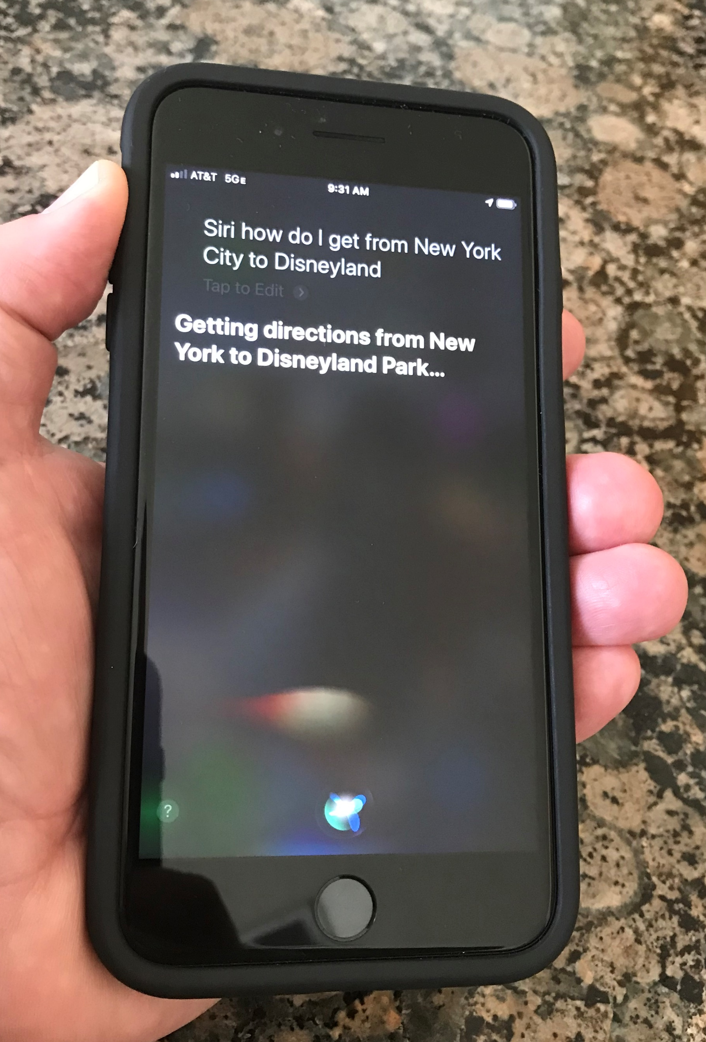
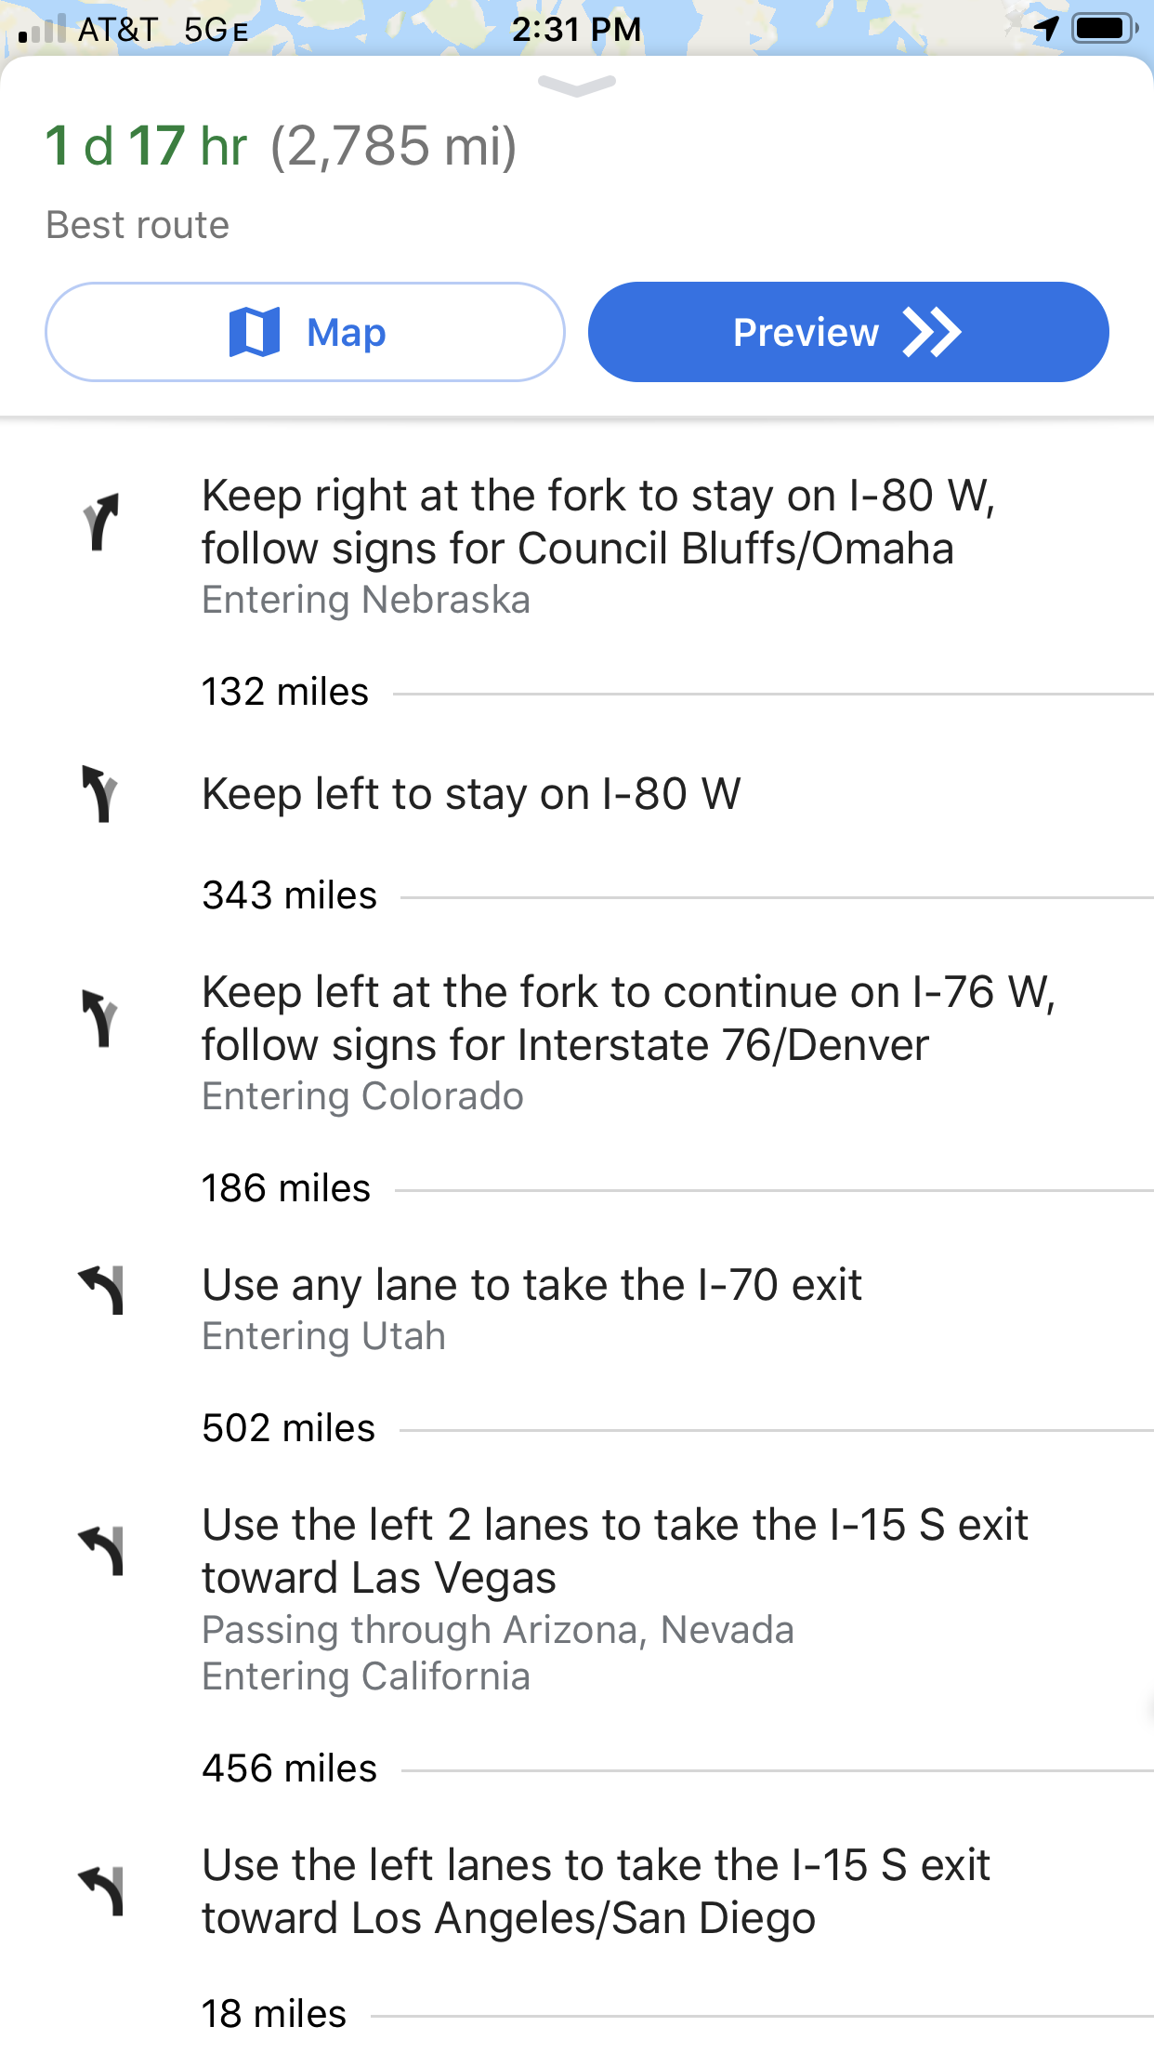
Today we can use the Global Positioning System to measure our location and guide us to a new locations.
Notes:
GPS has revolutionized our ability to locate our position and track our movement.

Slide 20
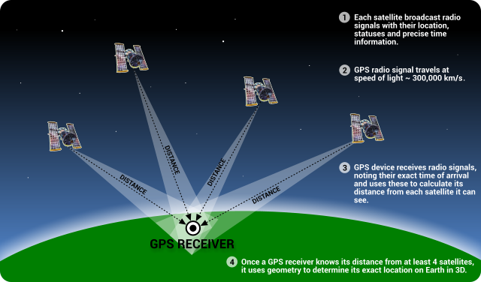
Notes:
A simple description of how GPS works: The information is transmitted using a digital format which we will learn about later in studying physics.
The exact method of determining latitude and longitude is not covered in the lesson. Students should recognize that the precise knowledge of the distances and angles of the satellites relative to their position can be used to geometrically determine their location. The precise timing is critical in the determination of the distances and angles.

Slide 21
Before we move on to using GPS let’s take a moment to appreciate some of the physics that goes into creating this system.
Notes:
Since this is likely to be one of the first activities in a physics class, the next few slides provide an exciting way to introduce some of the core disciplinary ideas that students will learn in physics and connect them to exciting applications.

Slide 22
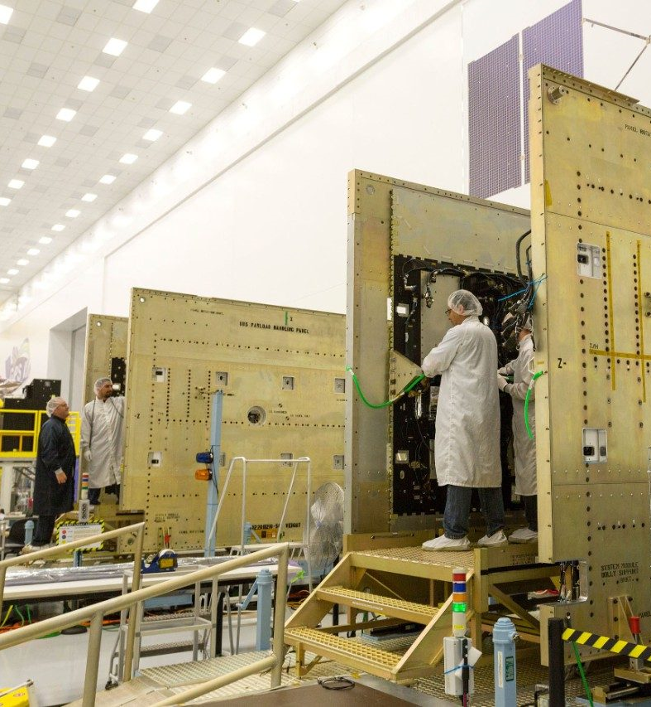
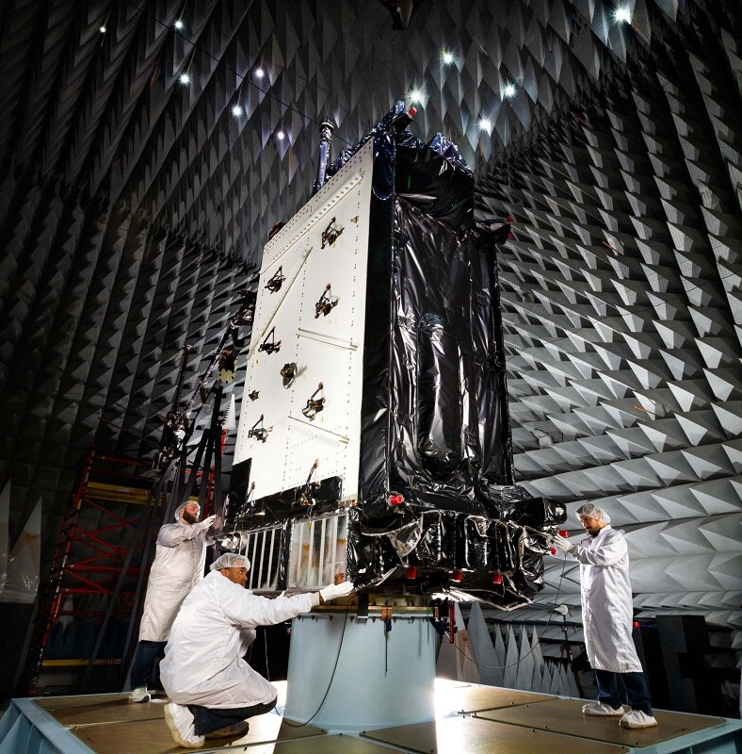
Notes:
Construction and testing of the satellites:
In physics we will learn the fundamentals of electricity/electronics, we will study the properties of different materials needed for construction of devices like satellites and we will explore engineering and scientific practices used in measurement and testing.

Slide 23
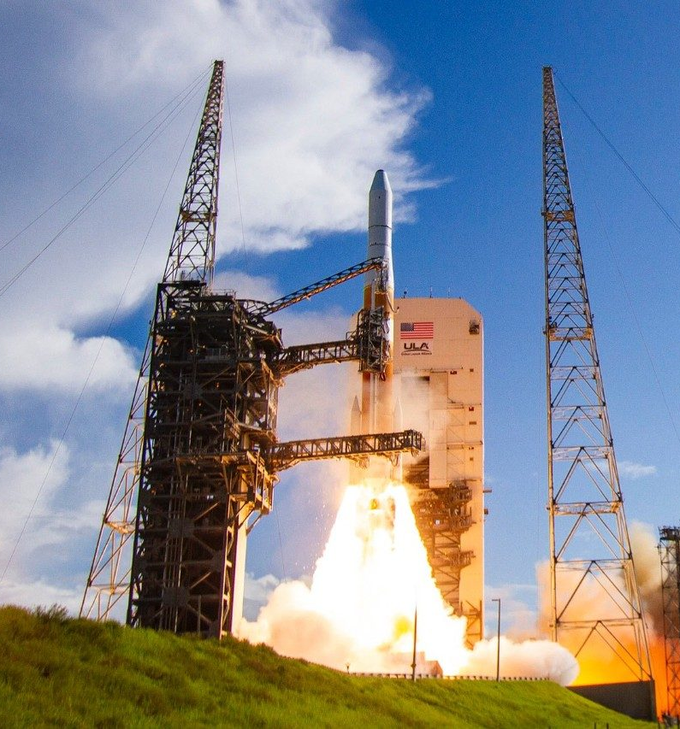
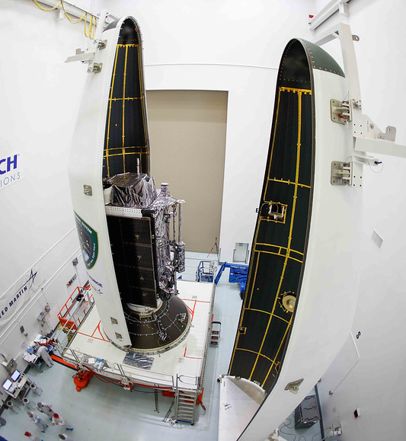
Notes:
Packaging and delivery of the satellites to their orbiting altitude:
In physics we will explore the gravitation force that “holds” objects on the ground and how potential chemical energy can be converted to a thrust force that can do the work needed to move rockets into space.

Slide 24
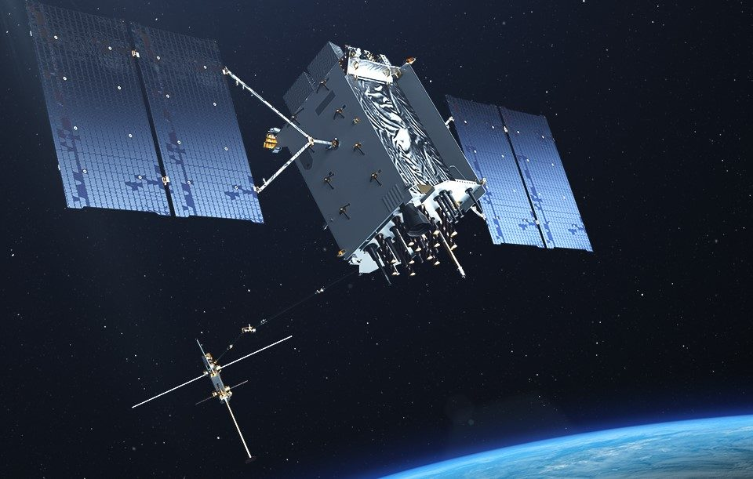
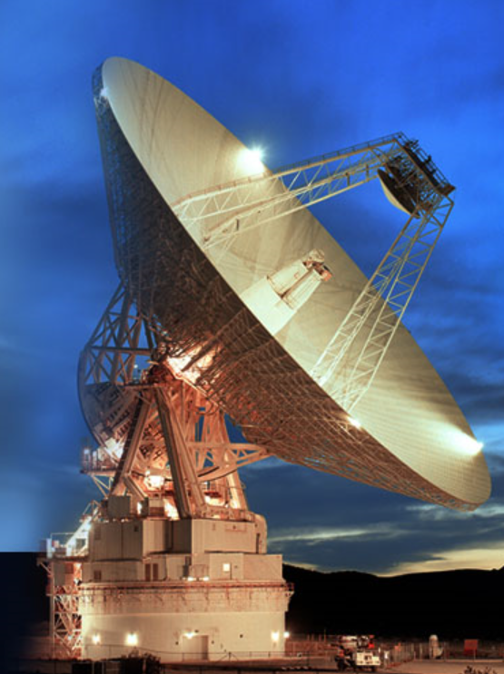
Notes:
Control and operation in space:
In physics we will explore energy conversion processes that allow the satellite to use electromagnetic radiation from the sun to power its operation and we will learn how digital signals enable rapid communications between the satellites in space and devices on Earth, such as your phone. We will also learn about how gravitational forces are used to maintain satellites in extremely precise orbits around the Earth.

Slide 25
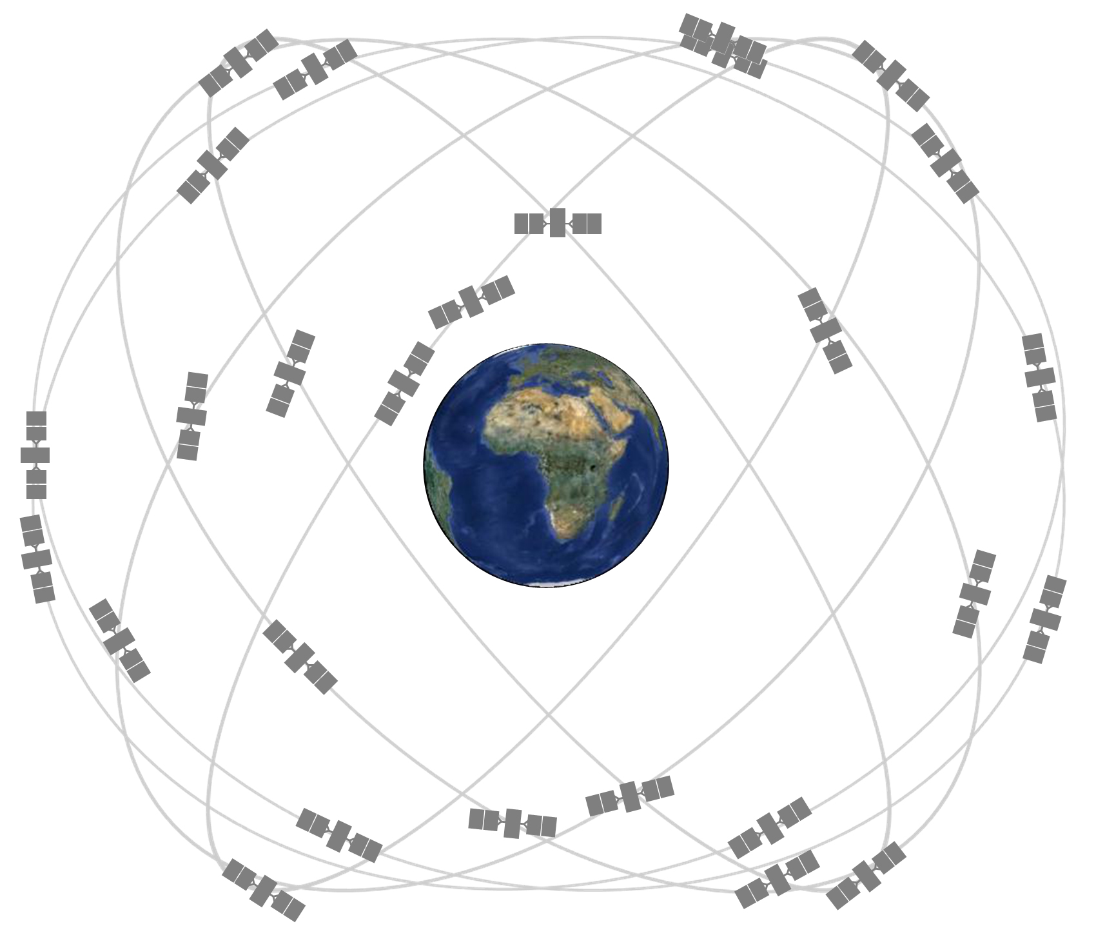
The GPS constellation makes use of 24 satellites arrange in six equally-space orbital planes.
Notes:
GPS satellites fly in medium Earth orbit (MEO) at an altitude of approximately 20,200 km (12,550 miles). Each satellite circles the Earth twice a day.
The satellites in the GPS constellation are arranged into six equally-spaced orbital planes surrounding the Earth. Each plane contains four "slots" occupied by baseline satellites. This 24-slot arrangement ensures users can view at least four satellites from virtually any point on the planet.

Slide 26
Introduce the Global Coordinate System

Slide 27
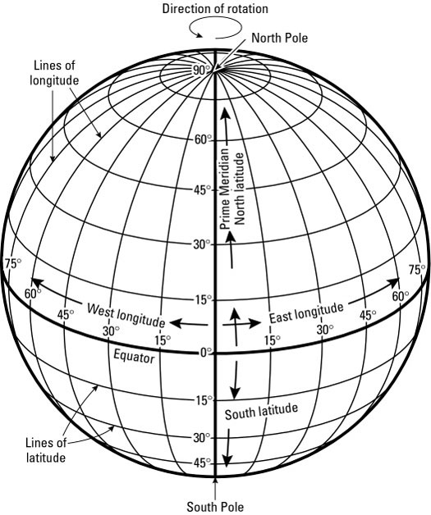
Geographic Coordinate
System
Imaginary lines of latitude and longitude define a coordinate system by means of which the position or location of any place on Earth’s surface can be determined.
Notes:
This provides a quick introduction to the geographic coordinate system. In this lesson we will be using latitude and longitude coordinates to measure displacement and velocity. The red dot indicates the location of zero latitude and zero longitude.
A little history: The decision to decide where place the zero-reference line for lines of longitude was decided at the International Meridian Conference hosted by the United States in 1884. Agreement by 22 of 25 nations was to adopt the longitudinal line going through the Royal Observatory in Greenwich, England as the zero-reference line. Unlike the scientifically-determined equator as the zero-reference line for latitude, the decision for where to designate zero longitude was a political decision.

Slide 28
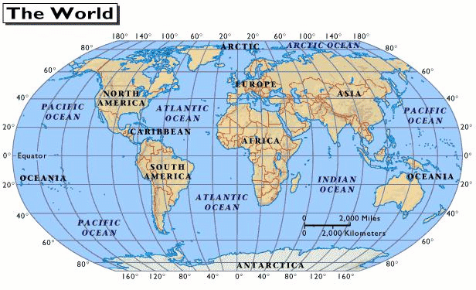
Notes:
Lines of latitude and longitude are shown as they relate to specific geographical locations.

Slide 29
Initial Exploration
Activity

Slide 30
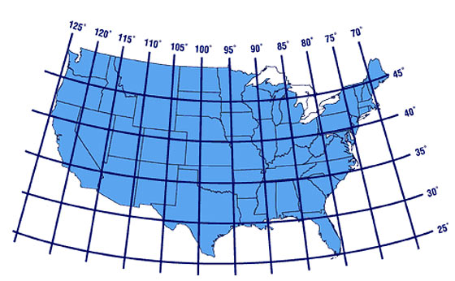
Estimate the GPS coordinates of your location from this graph.
Notes:
Have student estimate their location from interpolating values from the graph.

Slide 31
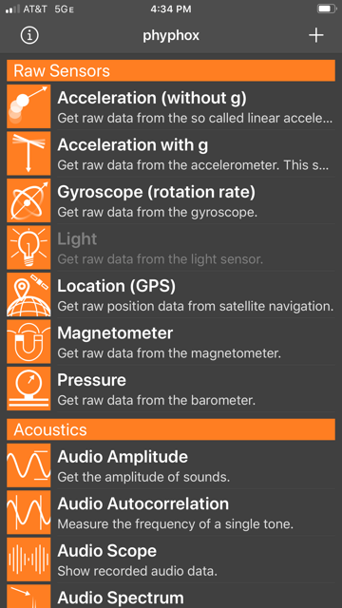
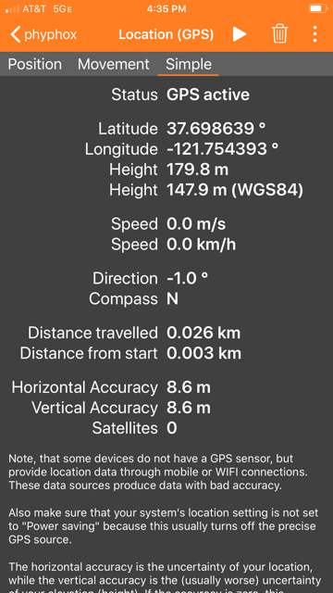
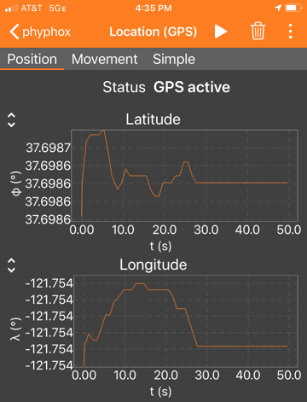
Use the GPS on your phone to measure your coordinates and compare to your estimate.
Notes:
There are multiple applications that will provide GPS readings. Phyphox works well and allows easy collection of data over time that will be used later in this exercise.
Note that depending on the visibility of satellites, it will sometimes take a few seconds to refine a location (see graphs in center panel). This measurement was done inside a house – you could easily determine what room in the house with this data. If satellites are not visible because they are obscured, the phone may use other devices to determine location such as local wifi or mobile data networks.
Students will see that the value of longitude is negative, indicating we are west of the Prime Meridian.

Slide 32
Significant Figures of GPS Measurements
How many digits are provided for the measurement of latitude and longitude?
How might you decide if they are all significant?
Notes:
Students should first look at how much the measurements fluctuate. They will notice that the fluctuations stop if the phone remains in the same location for a short period of time. They can then move away by a few meters and see that the numbers change to a new stable value. They should conclude that the latitude measurement has 8 significant figures and longitude measurement has 9 significant figures.

Slide 33
Experiment 1
Measuring Position using Latitude and Longitude

Slide 34
Experiment 1
Measuring Position (Latitude and Longitude) - Walking
  Collect location data as you can walk a straight line at constant pace.
    Using the phyphox “location” module collect data as you walk at a constant pace from point A to point B and back to point A. You do not need to know the exact distance; you will be determining that from the experiment. A distance of approximately 100 meters should work well. For the best results, choose a path where there is not a large change in elevation (no large hills).
      Let the sensor locate the satellites and refine your starting position at Point A for 20 seconds before you start walking to point B.
      When you arrive at point B, pause for ~10 seconds at point B and then walk back to point A at the same constant pace.
      Allow the application to collect ~ 10 seconds of data at your final location before saving and exporting for analysis.
  Screen capture the graphs of both latitude and longitude data vs time from the phyphox application. Export your data to a file for later use.
    Determine the direction you were walking (e.g., North East, South West, …).

Slide 35
Example Data

Slide 36
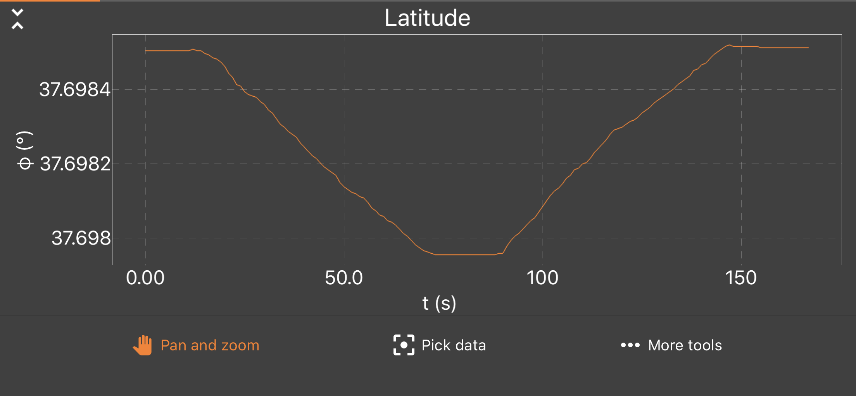
A
B
A
Notes:
Example latitude data: Note that the displacement is taking place along a straight line and can be described as a vector with both magnitude and direction.
Note that this will look different depending on the direction the person is walking.

Slide 37
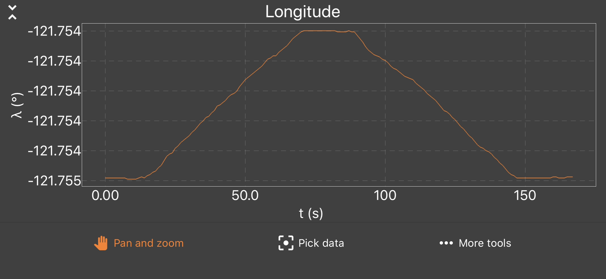
A
B
A
Notes:
Example longitude data: Note that the displacement is taking place along a straight line and can be described as a vector with both magnitude and direction.

Slide 38
Test your Understanding

Slide 39
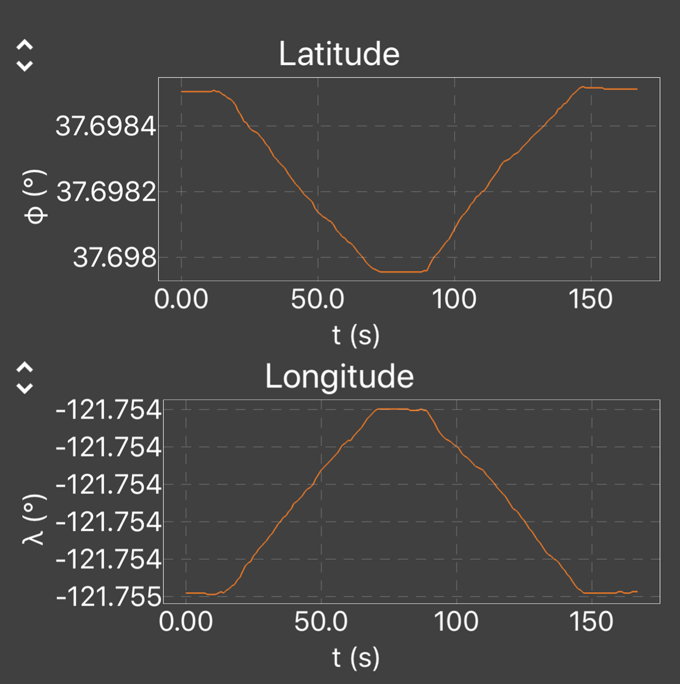
Test Your Understanding
In what direction was the person walking at t = 40 seconds?
N
NE
E
SE
S
SW
S
NW
Notes:
This exercise helps to solidify an understanding that displacement is a vector. Displacement takes place in a well-defined direction at any instant in time.

Slide 40
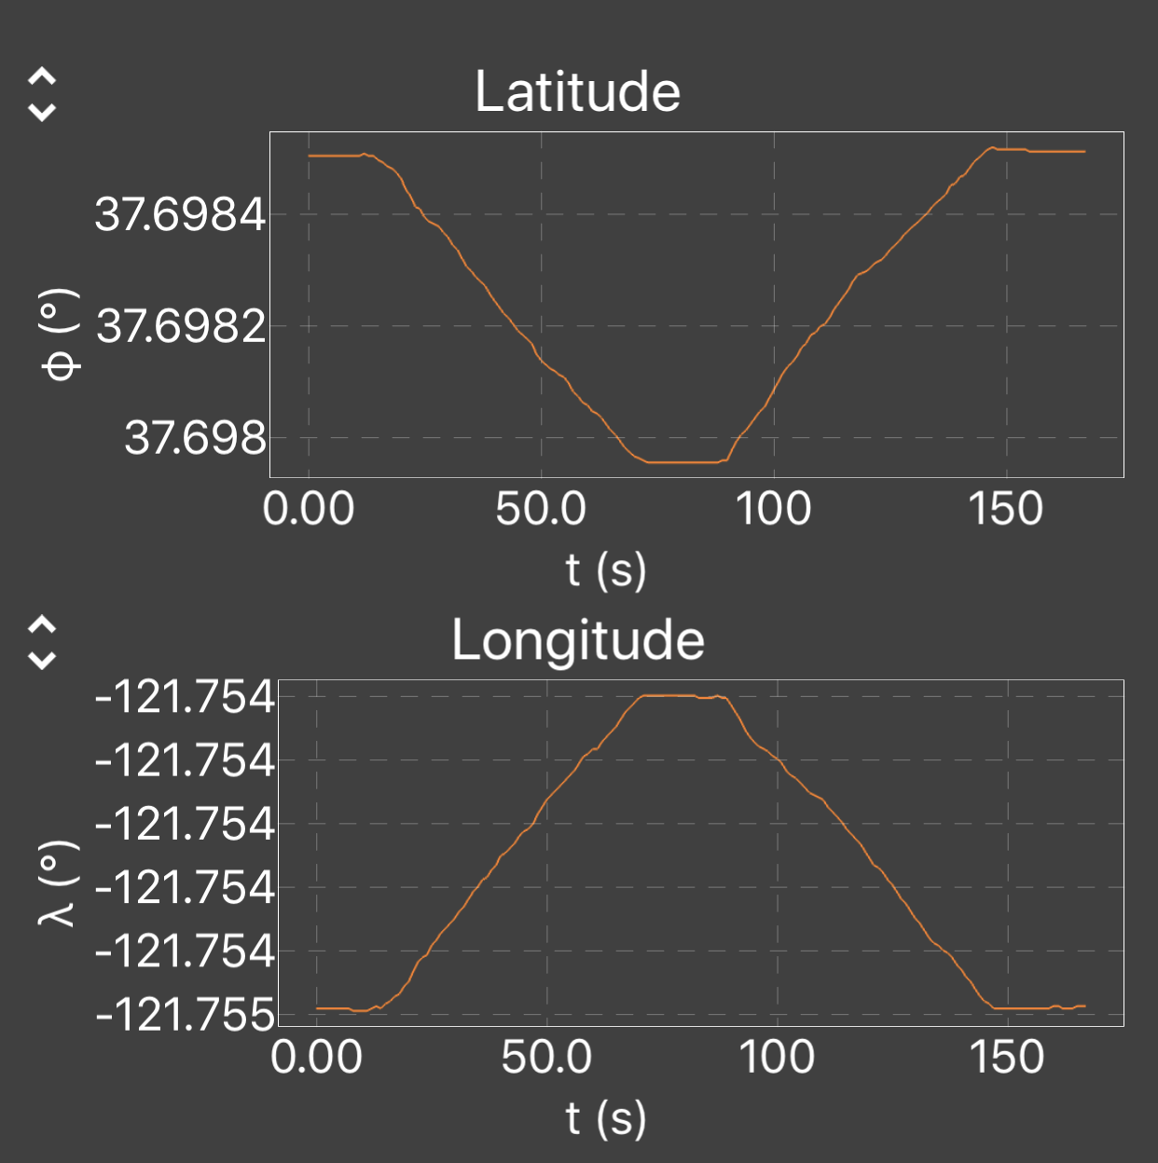
Test Your Understanding
In what direction was the person walking at t = 40 seconds?
N
NE
E
SE
S
SW
S
NW

Slide 41
Test Your Understanding
In what direction was the person walking at t = 50 seconds?
N
NE
E
SE
S
SW
S
NW

Slide 42
Test Your Understanding
In what direction was the person walking at t = 50 seconds?
N
NE
E
SE
S
SW
S
NW

Slide 43
Using Spreadsheets for Calculations and Graphing
Throughout the series of phone physics activities, there will be great benefit to using spreadsheets to perform calculations on data sets, create graphs, and analyze data.
This activity provides an opportunity to develop students' skills in using spreadsheets. The video link below is a great tutorial for introducing the use of spreadsheets for physics.
Harnessing the Power of Spreadsheet in Physics: https://www.youtube.com/watch?v=WRPH7Rv_LmQ
Notes:
Learning to use spreadsheets during this activity will lengthen the time for the activity but the investment will be rewarded in future activities as student become increasingly comfortable with using spreadsheets for graphing, calculations and analysis. Excel and Google Sheets are two options that work well for large data sets (some later activities will use thousands of data points).

Slide 44
Experiment 2
Plotting Data using a Spreadsheet

Slide 45
Experiment 2
Plotting Data using a Spreadsheet
  Use the data that was exported and saved from Experiment 1
  Create latitude vs time graph using your favorite spreadsheet.
    Include labels on your axes.
    Scale the data to allow effective visualization.
    Indicate the change of latitude on your graph.
  Create longitude vs time graph.
    Include labels on your axes.
    Scale the data to allow effective visualization.
    Indicate the change of longitude on your graph.

Slide 46
Example Graphs

Slide 47
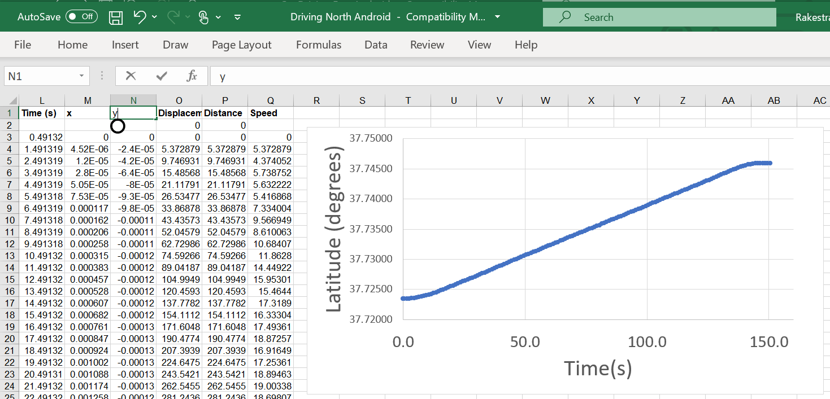
Using Excel for Calculations and Graphing
Notes:
Students can practice plotting the latitude and longitude data using the spreadsheet of their choice. Excel has been used for most of these analyses.

Slide 48
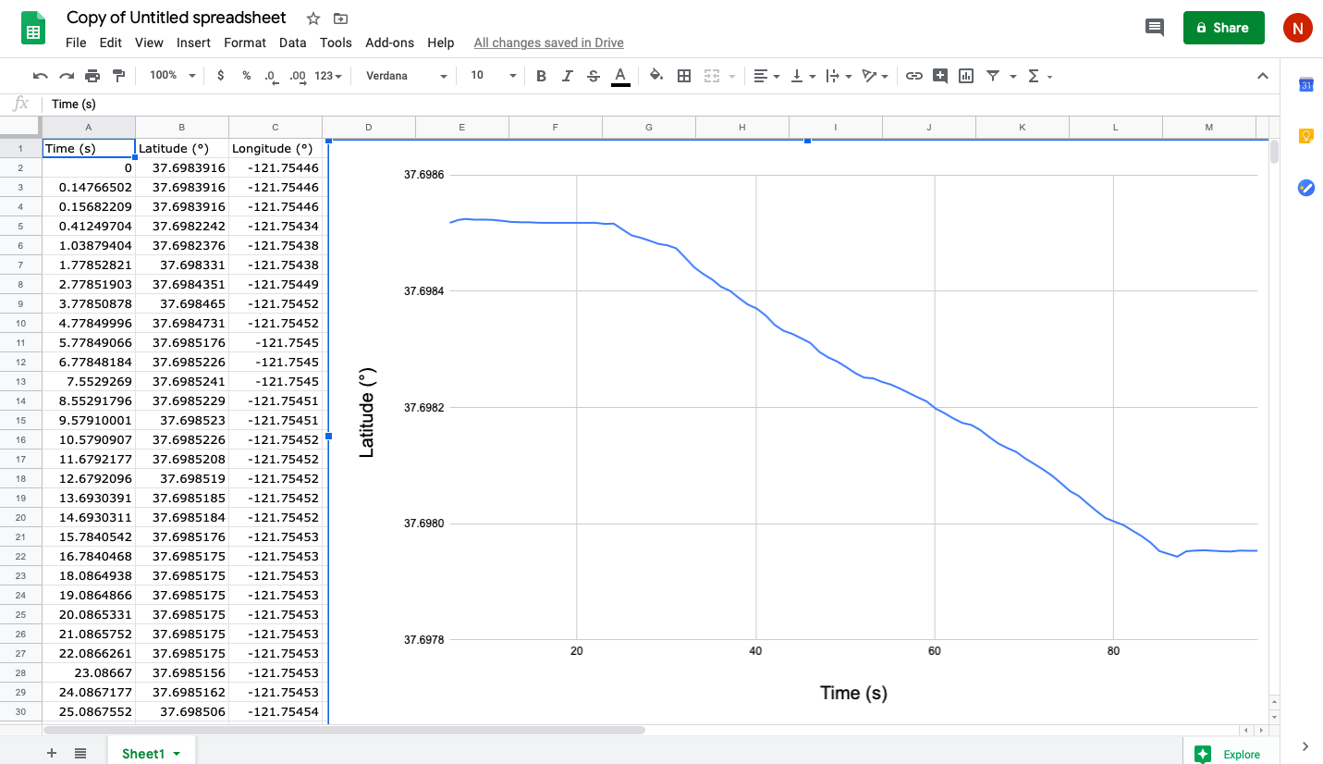
Using Google Sheets for Calculations and Graphing
Notes:
Students can practice plotting the latitude and longitude data using the spreadsheet of their choice. Googles Sheets is shown above.

Slide 49
Walking in Straight Lines: Latitude Variation
A
B
A
Notes:
Experiment:
Stand at point A for ~10 seconds
Walk to point B
Stand at point B for ~10 seconds
Walk back to point A
A quick walking pace will produce a more measurable change. In this data it is easy to see when the person is not moving and when they change directions. As expected, the latitude measurement at the end is the same (within the error of the measurement) as at the beginning.
Note that the change in latitude will be dependent of both speed of the walker and the direction. If the student is walking directly east or west, there will be no significant change in latitude.

Slide 50

Walking in Straight Lines
A
B
A
A
Latitude
$$∆ Latitude=−0.000555 °$$
B
Notes:
This is the same data as on the previous slide with additional annotation and the value for change in latitude indicated.
Experiment:
Stand at point A for ~10 seconds
Walk to point B
Stand at point B for ~10 seconds
Walk back to point A
A quick walking pace will produce a more measurable change. In this data it is easy to see when the person is not moving and when they change directions. As expected, the latitude measurement at the end is the same (within the error of the measurement) as at the beginning.
Note that the change in latitude will be dependent of both speed of the walker and the direction. If the student is walking directly east or west, there will be no significant change in latitude.

Slide 51
Walking in Straight Lines: Longitude Variation
A
B
A
Notes:
Experiment:
Stand at point A for ~10 seconds
Walk to point B
Stand at point B for ~10 seconds
Walk back to point A
A quick walking pace will produce a more measurable change. In this data it is easy to see when the person is not moving and when they change directions. As expected, the longitude measurement at the end is the same (within the error of the measurement) as at the beginning.
Note that the change in longitude will be dependent of both speed of the walker and the direction. If the student is walking directly north or south, there will be no significant change in longitude.

Slide 52

Walking in Straight Lines
A
B
B
Longitude
$$∆ Longitude=0.000982 °$$
A
A
Notes:
This is the same data as the previous slide with additional annotation and the value for change in longitude indicated.
Experiment:
Stand at point A for ~10 seconds
Walk to point B
Stand at point B for ~10 seconds
Walk back to point A
A quick walking pace will produce a more measurable change. In this data it is easy to see when the person is not moving and when they change directions. As expected, the longitude measurement at the end is the same (within the error of the measurement) as at the beginning.
Note that the change in longitude will be dependent of both speed of the walker and the direction. If the student is walking directly north or south, there will be no significant change in longitude.

Slide 53
Background Information for Experiment 3

Slide 54
Calculating the Distance between Two Points on the Earth’s Surface
Steps to determining formula:
Euclidean coordinates solution for distance between two points
Spherical coordinate system
Calculation for distance in spherical coordinate system for small displacements
Notes:
The next few slides provide a quick summary of how the equations used to calculate the distance between two point using latitude and longitude were derived. Teachers can decide how much detail they want to provide.

Slide 55
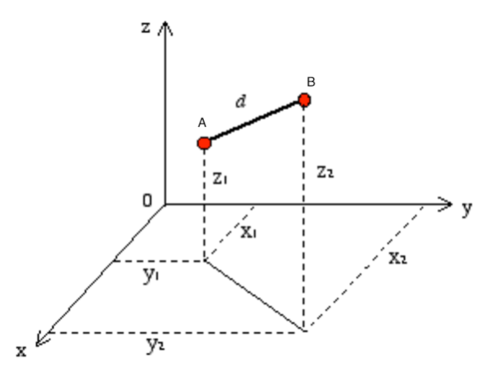
Calculation of the Distance between Two Points in Euclidean Coordinate System
$$d= \sqrt{{\left(x_{2}−x_{1}\right)}^{2}+{\left(y_{2}−y_{1}\right)}^{2}+{\left(z_{2}−z_{1}\right)}^{2}}$$
Notes:
Student may recall from their previous math classes how to calculate the distance between two points in a Euclidean coordinate system.

Slide 56
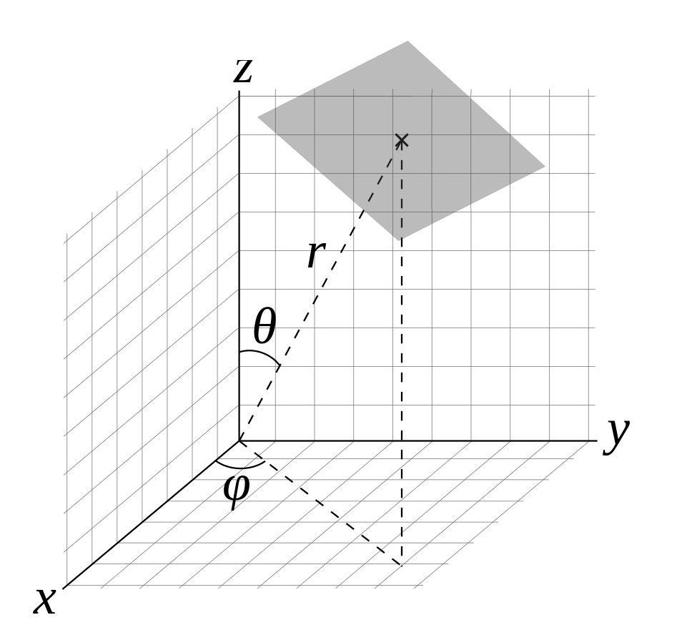
Spherical
Coordinates
In a spherical coordinate system, a point is identified by r, θ and φ.
We live on a round planet, so we need to use this system.
Notes:
Student may also be familiar with spherical coordinates.

Slide 57
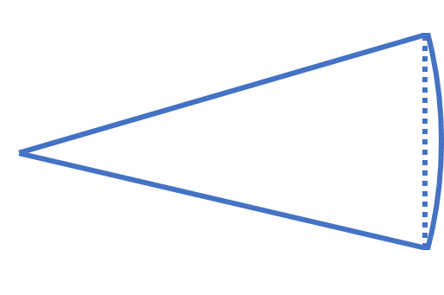
x₁
chord: c
arc: s
R
θ
x₂
Distance between x₁ and x₂ along a straight line is the cord length, c
c = 2Rsin(θ /2)
Distance between x₁ and x₂ along the arc is the arc length, s = Rθ
For R long and small θ, sin(θ) ≈ θ
c = 2Rsin(θ /2) ≈ Rθ = s

Slide 58
x₁
chord - c
arc - s
R
θ
x₂
As you travel a line of longitude, the radius of your circle is the radius of the earth, the angle that you cover is Lat₂ – Lat₁
Distance traveled along longitude (x) ≈ R(Lat₂ – Lat₁)

Slide 59
x₁
chord - c
arc - s
R
θ
x₂
As you travel a line of latitude, the radius of your circle depends on your longitude as R cos(Lat). (Latitude radius large at equator and small near the poles.) The angle you cover is Long₂ – Long₁.
In the small angle approximation:
Distance traveled along latitude (y) ≈ R cos(Lat) (Long₂ – Long₁)

Slide 60
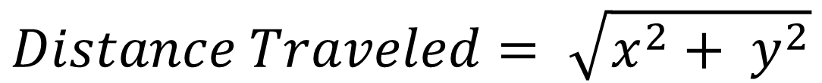
x₁
chord: c
arc: s
R
θ
x₂
When you change both longitude and latitude, combine the two like sides of the triangle to get the total distance traveled:
$$Distance Traveled= \sqrt{x^{2}+ y^{2}}$$

Slide 61

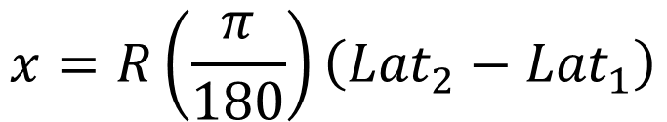


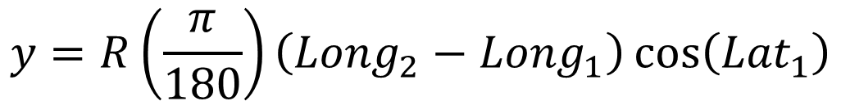
Equations for Calculating the Distance between Two Locations using Latitude and Longitude*
$$For locations with {Lat}_{1},{Long}_{1} and {Lat}_{2},{Long}_{2} in degrees:$$
$$x=R\left(\frac{π}{180}\right)\left({Lat}_{2}−{Lat}_{1}\right)$$
1
2
$$y=R\left(\frac{π}{180}\right)\left({Long}_{2}−{Long}_{1}\right)\cos\left({Lat}_{1}\right)$$
$$Distance=\sqrt{x^{2}+y^{2}}$$
$$where R=6,356 km$$
$$\left(radius of earth\right)$$
$$\left(\frac{π}{180}\right) is included to convert degrees to radians$$
Notes:
These equations will be used extensively in the remainder of the lesson. It is left to individual teachers to determine if they would like to spend more time on the math used to get from the previous slide to this one. For our two-dimensional (x,y) grid, the x axis is north and the y axis is east.
This is a simplified solution for short distances relative to the radius of the Earth. At short distances, it is possible to make small angle approximations which simplifies the equations. In this case, we are making calculations that are assuming we are moving along a plane surface and we are ignoring the curvature of the earth (a very good approximation for short distances). This assumption is why z does not appear in the solution except as the radius of the Earth – we are approximating it as a constant. The complete solution can be found using the haversine formula which accounts for the curvature of the Earth. (Interested students can investigate further.)

Slide 62
Experiment 3
Calculating Distance between two Locations Defined by Latitude and Longitude

Slide 63
Experiment 3
Calculating Distance between two Locations Defined by Latitude and Longitude
  Determine the distance between point A and point B using the formula for calculation distance between two locations using your calculator.
  Using the latitude and longitude data in your spread sheet from Part II:
    Calculate and plot displacement vs time.
      Indicate the maximum value of displacement on the graph.
    Calculate and plot the total distance traveled vs time.
      Indicate the total distance traveled on the graph and compare to the maximum displacement.

Slide 64
Calculation of Distance between Points A and B*
$$For points A \text{(3}\text{7.69850}\text{6},\text{−121.7545}\text{90)} and B \text{(3}\text{7.69795}\text{4, }\text{−121.753603}\text{)}$$
$$x=R\left(\frac{π}{180}\right)\left(\text{37.69795}4−\text{37.69850}6\right)=R\left(\frac{π}{180}\right)(−0.000552)$$
$$y=R\left(\frac{π}{180}\right)\left(\text{−121.753603}+\text{121.7545}90\right)\cos\left(37.698506\right)=R\left(\frac{π}{180}\right)(0.000781)$$
$$Distance=\left(6,356,000 m\right)\left(\frac{π}{180}\right)\sqrt{{\left(−0.000552\right)}^{2}+{\left(0.000781\right)}^{2}}=106 m$$
Notes:
This calculation provides an opportunity for students to practice their use of significant figures.

Slide 65
Embedded Excel Worksheet With Example Calculation
The formulas used in this two-location example can be used in calculating the displacement for every pair of locations in a larger data set.
Notes:
This is an embedded spreadsheet.

Slide 66
Example Data, Analysis, and Calculations

Slide 67

Walking in Straight Lines
A
B
B
Displacement
Displacement is a vector!
$$Displacement=106 m$$
A
A
Notes:
The displacement for each Position(latitude, longitude, time) is determined in reference to Position (latitude, longitude, time=0).
Experiment:
Stand at point A for ~10 seconds
Walk to point B
Stand at point B for ~10 seconds
Walk back to point A
The magnitude of the displacement vector was determined by calculating the distance between the position at time=0 and the position at time=t. (For this one-dimensional example, the displacement vector is described by its magnitude and a sign, which is taken to be positive at any position in the direction from A to B and beyond; the sign is negative at any position from A in the opposite direction along the same axis.)
We expect the displacement vector to be zero at the end of the walk since the person ends the walk at the same location as they started.

Slide 68


Walking in Straight Lines
A
B
Total Distance
A
Distance is a scalar!
B
$$Total Distance=212 m$$
$$d_{t}=\sum_{i=1}^{t}{\left|d_{i}−d_{i−1}\right|}$$
A
Notes:
The total distance can be calculated by summing the absolute values of the distance between each set of data points from time=0 to time=t.
Experiment:
Stand at point A for ~10 seconds
Walk to point B
Stand at point B for ~10 seconds
Walk back to point A
The distance was calculated by adding the absolute value of the displacement for each sequential set of points. As expected, the total distance was 2x the distance between A and B (the maximum displacement from the previous graph).

Slide 69
Experiment 4
Calculating Velocity and Speed

Slide 70
Experiment 4
Calculating Velocity and Speed
  Using the displacement vs time data:
    Calculate and plot instantaneous velocity vs time.
      The instantaneous velocity can be calculated using the change in distance between adjacent data points and the associated change in time.
    Calculate and plot the instantaneous speed vs time.
    Calculate the average velocity when walking from A to B.
      Use data for time periods where you were walking at constant velocity.
      The average velocity can be determining from the slope of displacement vs time graph.
    Calculate the average velocity when walking from B to A.

Slide 71
Example Data, Analysis, and Calculations

Slide 72
Walking in Straight Lines
A
B
Velocity
Velocity is a vector!
Notes:
The “instantaneous” velocity can also be estimated by measuring the displacement between two sequential points divided by the change in time (1.00 second for this data).
The magnitude of the velocity is relatively noisy due to the uncertainty in measuring each position (latitude, longitude).

Slide 73
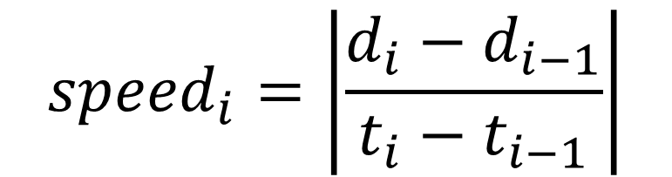
Walking in Straight Lines
A
B
Speed
$${speed}_{i}=\left|\frac{d_{i}−d_{i−1}}{t_{i}−t_{i−1}}\right|$$
Speed is a scalar!
Notes:
The graph displays the calculated speed for each sequential set of points. The calculations divides the absolute value of the displacement between pairs of points by the change in time (one second in this case).
The magnitude of the speed is relatively noisy due to the uncertainty in measuring each position (latitude, longitude).

Slide 74
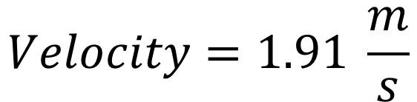
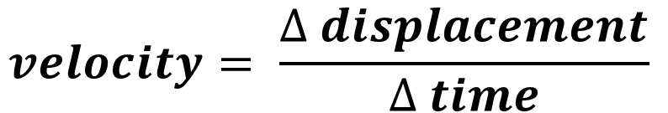
Walking in Straight Lines
A
B
$$velocity= \frac{∆ displacement}{∆ time}$$
B
$$Velocity=1.91 \frac{m}{s}$$
A
Notes:
The velocity can be determined more accurately by measuring the displacement as a function of time for a series of location points as a function of time. The noise of individual measurements is averaged out by fitting a larger number of points.
Data shown is for walking from point A to point B so that the sign of the velocity is positive.

Slide 75


Walking in Straight Lines
A
B
B
$$velocity= \frac{∆ displacement}{∆ time}$$
$$Velocity=−1.80 \frac{m}{s}$$
A
Notes:
This graph displays a similar fit to the data for walking from point B to point A. Since the displacement is negative, the velocity is also negative.

Slide 76
Experiment 5
Measuring Displacement and Velocity: Running

Slide 77
Experiment 5
Measuring Displacement - Running
  Collect location data as you run at a constant pace along the same straight line and distance as in the previous experiment.
    Use the same procedure for collecting the data as was done for walking.
  Plot both latitude and longitude data vs time on separate graphs
    Calculate and plot your displacement vs time.
    Calculate and plot the distance traveled vs time.
    Calculate the instantaneous velocity and graph the data.
    Using data during the time you were running at a constant pace, calculate the velocity from a displacement versus time graph and compare to the instantaneous velocity calculated in part 2c.
  Place both the walking and running displacement vs time data (for a single direction) on a single graph and describe the change in observed slope.

Slide 78
Example Data, Analysis, and Calculations

Slide 79
Running in Straight Lines: Latitude Variation
A
B
A
Notes:
Experiment:
Stand at point A for ~10 seconds
Run to point B
Stand at point B for ~10 seconds
Run back to point A
In this data it is easy to see when the person is not moving and when the runner changes direction. As expected, the latitude measurement at the end is the same (within the error of the measurement) as at the beginning.
Note that the change in latitude will be dependent of both speed of the runner and the direction. If the student is running directly east or west, there will be no significant change in latitude.

Slide 80
Running in Straight Lines
A
B
A
Latitude
A
$$∆ Latitude=−0.000555 °$$
B
Notes:
This is the same data as on the previous slide with additional annotation and the value for change in latitude indicated.
Experiment:
Stand at point A for ~10 seconds
Run to point B
Stand at point B for ~10 seconds
Run back to point A
In this data it is easy to see when the person is not moving and when the runner changes direction. As expected, the latitude measurement at the end is the same (within the error of the measurement) as at the beginning.
Note that the change in latitude will be dependent of both speed of the runner and the direction. If the student is running directly east or west, there will be no significant change in latitude.

Slide 81
Running in Straight Lines: Longitude Variation
A
B
A
Notes:
Experiment:
Stand at point A for ~10 seconds
Run to point B
Stand at point B for ~10 seconds
Run back to point A
In this data it is easy to see when the person is not moving and when the runner changes direction. As expected, the longitude measurement at the end is the same (within the error of the measurement) as at the beginning.
Note that the change in longitude will be dependent of both speed of the runner and the direction. If the student is running directly north or south, there will be no significant change in longitude.

Slide 82

Running in Straight Lines
A
B
B
Longitude
$$∆ Longitude=0.000947 °$$
A
A
Notes:
This is the same data as on the previous slide with additional annotation and the value for change in longitude indicated.
Experiment:
Stand at point A for ~10 seconds
Run to point B
Stand at point B for ~10 seconds
Run back to point A
In this data it is easy to see when the person is not moving and when the runner changes direction. As expected, the longitude measurement at the end is the same (within the error of the measurement) as at the beginning.
Note that the change in longitude will be dependent of both speed of the runner and the direction. If the student is running directly north or south, there will be no significant change in longitude.

Slide 83

Running in Straight Lines
A
B
B
Displacement
Displacement is a vector!
$$Displacement=105 m$$
A
A
Notes:
The displacement for each Position(Lat, Long, t) is determined in reference to Position(Lat, Long, t=0).
Experiment:
Stand at point A for ~10 seconds
Run to point B
Stand at point B for ~10 seconds
Run back to point A
The magnitude of the displacement vector was determined by calculating the distance between the position at time=0 and the position at time=t. The displacement is in the positive direction.

Slide 84

Running in Straight Lines
A
B
Total Distance
A
B
$$Total Distance=211 m$$
$$d_{t}=\sum_{i=1}^{t}{\left|d_{i}−d_{i−1}\right|}$$
A
Notes:
The total distance can be calculated by summing the absolute values of the distance between each set of data points from time=0 to time=t.
Experiment:
Stand at point A for ~10 seconds
Run to point B
Stand at point B for ~10 seconds
Run back to point A
The distance was calculated by adding the absolute value of the displacement for each sequential set of points. As expected, the total distance was 2x the distance between A and B (the maximum displacement from the previous graph).

Slide 85
Running in Straight Lines
A
B
Velocity
Velocity is a vector!
Notes:
The “instantaneous” velocity can also be estimated by measuring the displacement between two sequential points divided by the change in time (1.00 second for this data).

Slide 86

Running in Straight Lines
A
B
Speed
$${speed}_{i}=\left|\frac{d_{i}−d_{i−1}}{t_{i}−t_{i−1}}\right|$$
Notes:
The instantaneous speed can be determined by measuring the displacement as a function of time.
The graph displays the calculated speed for each sequential set of location points. The calculations divides the absolute value of the displacement between pairs of points by the change in time (one second in this case).

Slide 87


Running in Straight Lines
A
B
$$velocity= \frac{∆ displacement}{∆ time}$$
B
$$Velocity=4.78 \frac{m}{s}$$
A
Notes:
The velocity can be determined more accurately by measuring the displacement as a function of time for a series of location points as a function of time. The noise of individual measurements is averaged out by fitting a larger number of points.
Data shown is for running from point A to point B.

Slide 88


Running in Straight Lines
A
B
$$velocity= \frac{∆ displacement}{∆ time}$$
B
$$Velocity=−4.80 \frac{m}{s}$$
A
Notes:
This graph shows a similar fit to the data for running from point B to point A. Since the displacement is negative, the velocity is also negative.

Slide 89


Comparing Rate of Displacement for Walking and Running
$$Velocity=4.78 \frac{m}{s}$$
$$Velocity=1.91 \frac{m}{s}$$
Notes:
The larger value of the slope for running compared to walking is apparent.

Slide 90
Additional Example Showing the Slope of Displacement vs Time for Different Velocities:
Walk
Jog
Run

Slide 91
Displacement vs Time for Three Different Velocities

Slide 92
Experiment 6
Measuring Displacement and Velocity along Lines of Latitude or Longitude: Driving

Slide 93
Experiment 6
Measuring Displacement - Driving
  Collect location data as you drive at a constant speed along a straight line. This is a team activity to be done with an adult driver as you collect data. Choose a location where you can safety drive a constant speed while collecting data.
    Collect data while driving along a road that appears to be going as close to north-south as possible.
    Collect data while driving along a road that appears to be going as close to east-west as possible.
  Plot both latitude and longitude data vs time on separate graphs
    Examine the latitude and longitude data and discuss your observations about traveling parallel to latitude or longitude lines.
    Calculate and plot the distance traveled.
    Using data during the time you were driving at constant pace, calculate the velocity from a displacement versus time graph.
    Calculate the instantaneous velocity, graph the data and compare to the average velocity calculated in part 2c.

Slide 94
Example Data, Analysis, and Calculations

Slide 95

Experiment:
Drive carefully on a road that appears to be due north from a map
Accelerate from stationary position
Move at constant velocity – just above 40 mph for approximately 2.5 miles
Decelerate to a stop
North
Notes:
This experiment will show data for much higher velocities and also demonstrate the relatively small changes in longitude when traveling parallel to lines of longitude.

Slide 96

Driving North in a Straight Line
Data for car moving north at a constant velocity
$$∆ Latitude=0.019827°$$
Notes:
A very uniform and significant change in latitude is observed which is consistent with a constant velocity in the northern direction.
Data for the starting and stopping process are not shown here to simplify the graphic.

Slide 97
Driving North in a Straight Line
Data for car moving north at a constant velocity
$$Variation in Longitude \sim ±0.00002 °$$
Notes:
The very small change in longitude measurement indicates that the bearing of the car is directly north as expected from observing the map.

Slide 98
Driving North in a Straight Line
Data for a car:
Accelerating from stationary position
Moving at constant velocity
Decelerating to a stop
Displacement = 2497 m North
Notes:
This graph shows the displacement calculated from the latitude and longitude data over the entire experiment. The positive (i.e., northerly) displacement was determined by calculating the distance between the location at time=0 to the location at time=t.

Slide 99
Driving North in Straight Lines
Moving at constant velocity
Slowing to a stop
Accelerating
Notes:
A change in the rate of change (slope of the graph) can be observed as the car changes velocity (i.e., accelerates) from the initial value of zero to the steady state velocity. Similarly one can see the change in the rate of change as the car comes to a stop at the end (i.e., negative acceleration).

Slide 100

Driving North in Straight Lines
$$Velocity=18.5\frac{m}{s}$$
Notes:
This graph shows the instantaneous velocity determined from sequential displacement values.

Slide 101
Driving North in Straight Lines
Data for the time period where the car is moving north at a constant velocity
Notes:
The initial and final data was removed from this graph so only the data for constant velocity is plotted. The selected data is used to determine a best linear fit on the following graph.

Slide 102


Driving North in Straight Lines
$$Velocity=18.5\frac{m}{s}$$
$$(41.4 mph)$$
Notes:
The velocity can be determined by measuring the displacement as a function of time for a series of location points as a function of time. The noise of individual measurements is averaged out by fitting a large number of data points.

Slide 103

Driving East
Experiment:
Drive care on road that appears to be due east from map
Accelerate from stationary position
Move at constant velocity – just above 50 mph for approximately 2.0 miles
Decelerate to a stop
East
Notes:
This experiment will produce data for high velocities and also demonstrate the relatively small changes in latitude when one travels parallel to lines of longitude.

Slide 104
Driving East in Straight Lines
Very small change in latitude when traveling directly east.
$$Variation in Latitude \sim 0.00017 °$$
Notes:
The very small change in latitude indicates that the car is traveling either directly east or west. In this case, it is east.

Slide 105

Driving East in Straight Lines
Data for car moving east
$$∆ Longitude=0.022432°$$
Notes:
A significant change in longitude is observed. This data includes the values before the vehicle started and for a short time after it had stopped. The car was moving at a constant velocity in the easterly (positive) direction for most of the trip.

Slide 106

Driving East in Straight Lines
Data for car moving east
$$Displacement=1974 m$$

Slide 107
Driving East in Straight Lines
Data for the time period where the car is moving east at a constant velocity
Notes:
The initial and final data was removed from this graph so only the data for constant velocity is plotted. The selected data is used to determine a best linear fit on the following graph.

Slide 108


Driving East in Straight Lines
$$Velocity=23.0\frac{m}{s}$$
$$(51.4 mph)$$
Notes:
The velocity can be determined by measuring the displacement as a function of time for a series of location points as a function of time. The data appears to be very uniform. The velocity was in good agreement with the car’s speedometer reading that the speed was maintained at just above 50 mph.

Slide 109

Driving East in Straight Lines
$$Velocity=23.0\frac{m}{s}$$
Notes:
This graph shows the instantaneous velocity determined from sequential displacements values.

Slide 110
Experiment 7
Measuring Displacement and Distance in Two Dimensions

Slide 111
Experiment 7
Measuring Displacement and Distance in Two Dimensions
  In a large open area, place three objects to guide your walking direction in a large triangle pattern.
    Collect data while walking at a constant pace between the three objects that direct your walking in a complete triangle.
    Start and finish at the same object (location).
    Collect data for ~20 second at the start and the end of your walk to allow for accurate measure of your beginning and ending position (which should provide very similar coordinates).
  Plot both latitude and longitude data vs time on separate graphs.
  Plot both displacement and distance on the same graph.
  Draw a diagram of the triangle with the appropriate distances on each leg of the triangle.
Notes:
This experiment works best in large open space with clear view of the surrounding sky to provide best signal reception from satellites.

Slide 112
Example Data, Analysis, and Calculations

Slide 113
Displacement and Distance in Two Dimensions: Latitude
2
3
2
3
1
1
1
Notes:
Latitude data from walking at a relatively constant pace between three locations. The numbers next to the graph indicate the time at which the walker was at that location. The walker paused at the location 1 at the beginning and end of the walk.

Slide 114
Displacement and Distance in Two Dimensions: Longitude
1
1
3
2
3
1
2
Notes:
Longitude data from walking at a relatively constant pace between three locations. The numbers next to the graph indicate the time at which the walker was at that location. The walker paused at the location 1 at the beginning and end of the walk.

Slide 115
Displacement and Distance in Two Dimensions
2
3
1
Notes:
The displacement and distance were calculated from the latitude and longitude data. One change in direction is very apparent in this graph; the second is noticeable by a change in the slope of the displacement line during the return to position 1.

Slide 116
Displacement and Distance in Two Dimensions
2
3
2
1
1
Notes:
While walking in one direction, the displacement and the distance are identical.

Slide 117
Displacement and Distance in Two Dimensions
2
59 m = 148 m – 89 m
89 m
3
3
1
Notes:
The distance continues to increase when the walker changes direction at position 2 and walks toward position 3.
The displacement decreases as the walker begins to walk toward position 3. The displacement can be represented by the sum of the two vectors shown in the diagram.

Slide 118
Displacement and Distance in Two Dimensions
2
59 m
89 m
3
29 m = 177 m – 59 m – 89 m
1
Notes:
The displacement approaches zero (within the error of the measurement) as the walker approaches the original location.

Slide 119
Test your Understanding

Slide 120
Test Your Understanding
Angelina took a walk to get some exercise and collected GPS data. She always walked in straight lines and took 90° turns when she changed direction. The data is plotted on the following page.
What is the relationship between the starting and ending locations?
How many turns did she make?
Label the direction for each segment of the walk.
Estimate how far Angelina walked.

Slide 121
Start
Stop

Slide 122
Start
Stop
SW
SE
NE
NW
Notes:
The starting point and ending point have the same values of latitude and longitude so Angelina ended in the same location from which she started.
Angelina made three 90 degree turns that were not equally spaced so she must have walked in a rectangle.
Direction:
Started SW
Next SE so must have made left hand turn
Next NE so must have made left hand turn
Next NW so must have made left hand turn

Slide 123

Start
Stop
Estimate total walking distance using the value for average walking speed from earlier data and the time walking (~350 s).
$$350 s \left(\frac{1.9 m}{s}\right)= 670 m$$

Slide 124
Challenge Activity
Position yourself in the middle of an open area such as a grass field. While looking at the real-time graph of latitude and longitude, try walking in different directions until you are walking directly:
South
2) West
Provide graphs of your wandering.

Slide 125
Latitude and Longitude Data – Finding a Southward Trajectory
Walking South

Slide 126
Latitude and Longitude Data – Finding a Westward Trajectory
Walking West

Slide 127
Motion in our Lives
Satellite based telemetry combined with low cost ground-based devices enable a wide range of opportunities to design and develop applications.
How might you use GPS to monitor movement?

Slide 128



Real-time data of current traffic and historic data of traffic patterns, inform our driving decisions.

Slide 129




Wildlife Telemetry
Notes:
Wildlife telemetry systems are used to locate animals in wildlife research for a variety of purposes including the study of:
predator-prey interactions
foraging behavior
activity patterns
movement patterns
migratory routes
habitat preference

Slide 130


The travel patterns of individual eagles are displayed
Notes:
Technological advances in size, weight, performance and cost will provide more opportunities for understanding wildlife and enabling people to better protect animals and their habits.
Each of the colors in the plot show the location of different eagles over the period of a year.

Slide 131


Data on the Position of People and their Movement has Great Value to Businesses

Slide 132

The location of phones as a function of time can be used to infer how far a person travels each day. The plot above shows the change the distance people traveled during the early days of the COVID-19 pandemic. In this case, an ~45% reduction in distance traveled is observed following stay at home orders.

Slide 133


Life at Constant Velocity in Straight Lines would be Very Boring
Next up Accelerated Motion

Slide 134
Supplemental Experimental Activity
Simple Measurement of
Displacement vs Time to Determine Velocity

Slide 135



Determine Walking Velocity by Measuring Displacement vs Time
5 meters
5 meters
5 meters
5 meters
5 meters
Notes:
Using the lap timer to measure the on your smartphone to measure the time at which you pass each cone.

Slide 136
Walking in Straight Line at Constant Velocity
Distance (m) | Time (s) Trial 1 | Time (s) Trial 2 | Time (s) Trial 3
0.0 | 0.0 | 0.0 | 0.0
5.0 | 3.25 | 2.98 | 2.96
10.0 | 6.28 | 5.74 | 5.62
15.0 | 9.18 | 8.54 | 8.47
20.0 | 12.10 | 11.03 | 11.53
25.0 | 15.25 | 13.77 | 14.21
Notes:
Measuring time to each cone spaced 5.0 meters apart. The walker attempted to maintain a constant pace during the walk for each of the three trials.

Slide 137
Walking in Straight Line at Constant Velocity – Trial #1
Velocity = 1.66 m/s

Slide 138
Walking in Straight Line at Constant Velocity – Trial #2
Velocity = 1.83 m/s

Slide 139
Walking in Straight Line at Constant Velocity – Trial #3
Velocity = 1.66 m/s

