Slide 1
ROTATIONAL MOTION
The Physics of Rotational Motion part 3
Notes:
LLNL-PRES-761938

Slide 2
Example Data

Slide 3
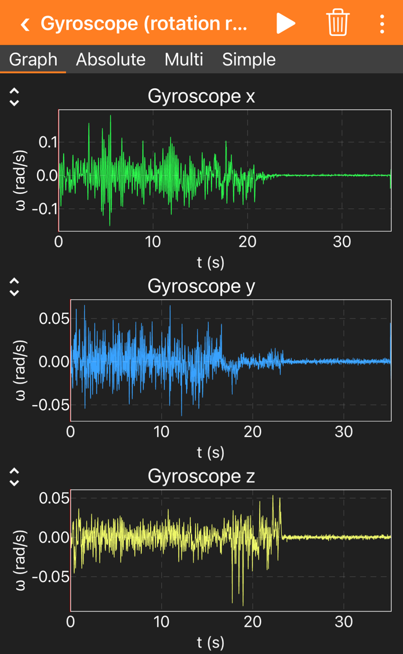
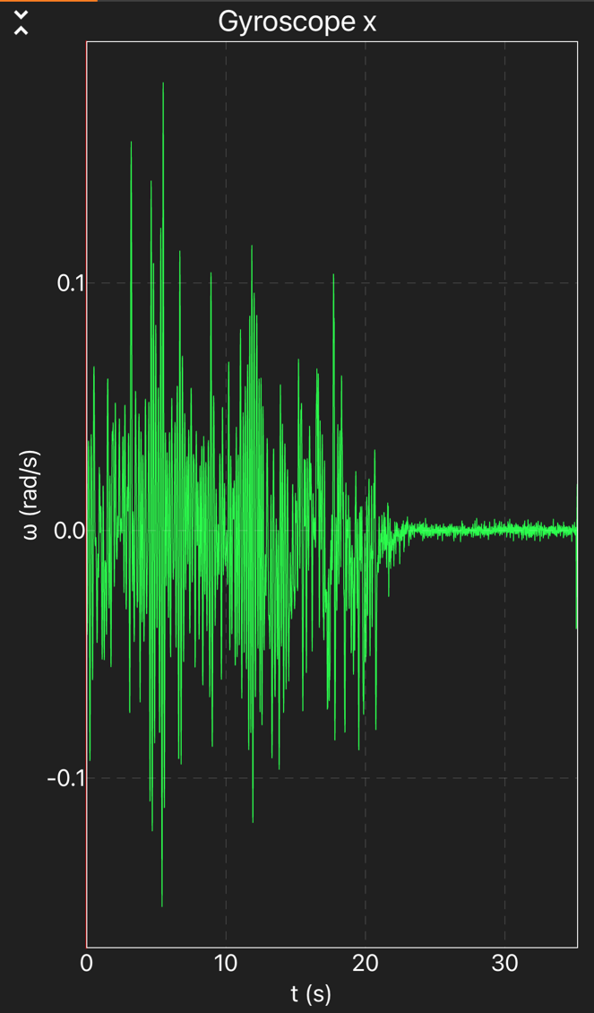
Phone held in hand
Phone transferred gently to table
Phone resting on table
1
2
3
1
2
3
This experiment demonstrates that physiologic tremors result in changes in angular velocity which are significantly larger than the background noise of the gyroscope sensor.
1
2
3
Notes:
Data collected on an iPhone 12 Pro Max.
The phone was slid slowly onto the edge of the table from the side to minimize large changes in acceleration in the transition from the hand to the table. Unless the transfer to the table is done very carefully, transferring the phone on the table can produce a larger changes in acceleration during the transition. While students will still be able to compare the measurements in their hands to being on the table by zooming in on the data, the careful transfer will provide a more striking visual effect as seen above.

Slide 4
Angular Velocity
Data from Experiment on Previous Slide
In hand
Notes:
Data from experiment on previous page was exported to a spreadsheet for graphing and analysis.
Data collected on an iPhone 12 Pro Max.

Slide 5


z-Axis Angular Velocity
Standard Deviation
$$σ_{in hand}=0.025 rad/s$$
$$σ_{on table}=0.001 rad/s$$
The angular velocity resulting from involuntary hand movement is 25x greater than the background noise of the gyroscope sensor.
Notes:
The z-axis data is used for demonstration purposes, but all three axis produce similar conclusions. Standard deviations are calculated using the STDEV.P function in MS Excel for the data collected during the time period indicated by the brackets.
This experiment demonstrates that sensitivity of the gyroscope is sufficient to measure the tremors of the hand which are 25 times greater than the noise of the sensor.
Data collected on an iPhone 12 Pro Max.

Slide 6
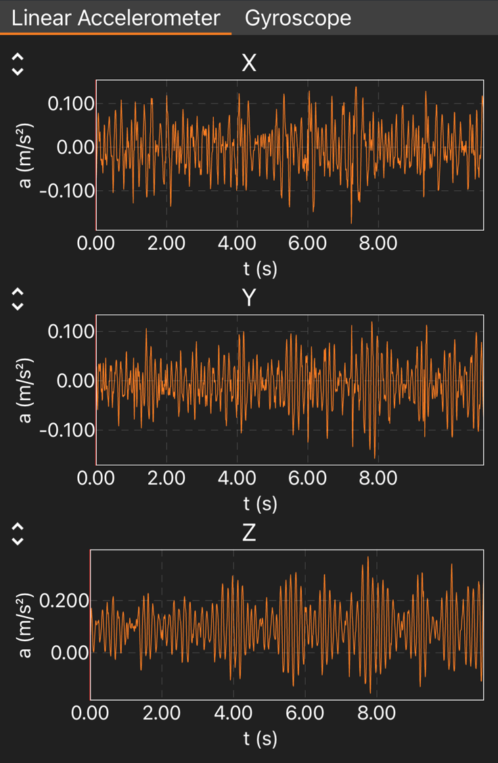
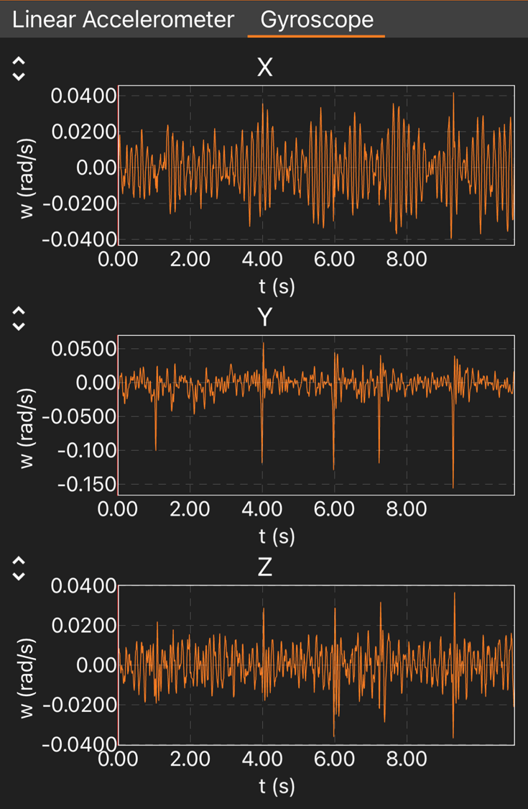
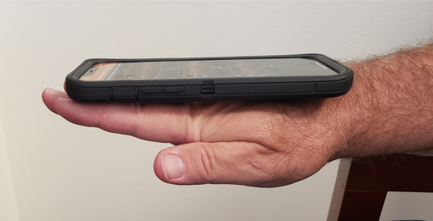
Tremor Measurement
Acceleration (without g) and gyroscope data collected simultaneously at ~100 Hz using iPhone 12.
Initial Observation
The “average” amplitude of the movement varies along different axes
Much of the movement results in a regular pattern—not random
Notes:
Example data collected with an iPhone 12 Pro Max in a case.
The forearm was placed on the armrest of a chair so that the arm was completely relaxed. The observed movement from physiological tremors will be isolated to that of the wrist/hand combination.
Data was collected for 11 seconds to assure that >1024 points were available for the FFT analysis.

Slide 7

Regular Oscillations
Notes:
The experiment was repeated multiple times which were used to confirm that patterns for the different axes were observed were consistent. The largest magnitude and most uniform oscillation pattern was measured by the z-axis of the accelerometer. There was also a very uniform oscillation pattern around the x-axis of the gyroscope. The y-axis accelerometer also routinely produced a relatively uniform oscillation pattern.
Acceleration around the x-axis and rotation around the y and z axes appeared to be lest uniform. The y and z gyroscope occasionally experienced rapid movements which did not follow any visual pattern.
It should be noted that the presence of less regular patterns could result from the interference of multiple frequencies combined with noise. Further analysis is required beyond visual inspection.

Slide 8
z-Axis Acceleration
Time Domain
Standard Deviation = 0.088 m/s²
Notes:
The data from the previous slide was exported to MS Excel for graphing and analysis.
The standard deviation of the x-axis acceleration was calculated to be 0.088 m/s² using the STDEV.P function.
Physiological tremors result in significant movement along the z-axis as measured by the z-axis accelerometer. The movement is visually periodic with a period of ~0.14 s.

Slide 9
z-Axis Acceleration
Calculation of Velocity and Displacement from Acceleration
Notes:
The velocity and the displacement were calculated from the measured acceleration. The details of the analysis can be found in the embedded spreadsheet. Offsets to the acceleration, velocity, and displacement were included in the analysis (the acceleration offset was adjusted to produce velocity and displacement values that demonstrated symmetry around zero). Given the design of this experiment, the time associated with zero velocity (or zero displacement) is not known so it is necessary to guess initial values that make the calculated values symmetric around zero. In addition, the very small movement makes any drift in the accelerometer signal output significant when trying to calculate the velocity and displacement over time. Therefore, the analysis focuses on a short time frame (e.g.,1 s), which is sufficient to see the displacement oscillations and an estimation of the magnitude of the movement.

Slide 10
z-Axis Acceleration
Estimation of Displacement due to Tremors
Displacement of tremors is ≈ ±0.05 mm
Notes:
The estimated peak-to-peak displacement resulting from physiologic tremors is on the order of 0.1 mm which is consistent with reports in the scientific literature.

Slide 11


z-Axis Acceleration
Estimate Primary Frequency of Tremor
$$f=\frac{4.0 cycles}{\left(5.886s−5.317s\right)}=7.0 Hz$$
$$f=\frac{5.0 cycles}{\left(8.306s−7.606s\right)}=7.1 Hz$$
Notes:
The frequency of the oscillation is estimated by measuring the time at which the acceleration reaches a maximum positive value for a selected number of cycles.
Other contributions to the acceleration are also present but the primary oscillation can be easily visualized.

Slide 12
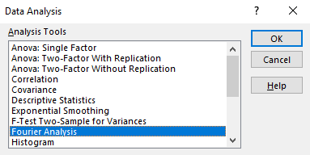
Time Domain → Frequency Domain
Conducting FFT using Analysis Tools in MS Excel
1) Select “Data” and then “Data Analysis.”
2) Choose “Fourier Analysis”
YouTube video: FFT in excel for spectral analysis - YouTube
Notes:
The next few slides illustrate the steps for using the Fourier Analysis in MS Excel to transform the amplitude data in the time domain to a power spectrum in the frequency domain. I learned how to do it for the first time from the video link.
You will need to add the Data Analysis ToolPak if it is not already installed in your MS Excel.
There are many other possible tools available to do this analysis that might be better for students depending on their backgrounds. I do not know how to do this in Google Sheets.

Slide 13
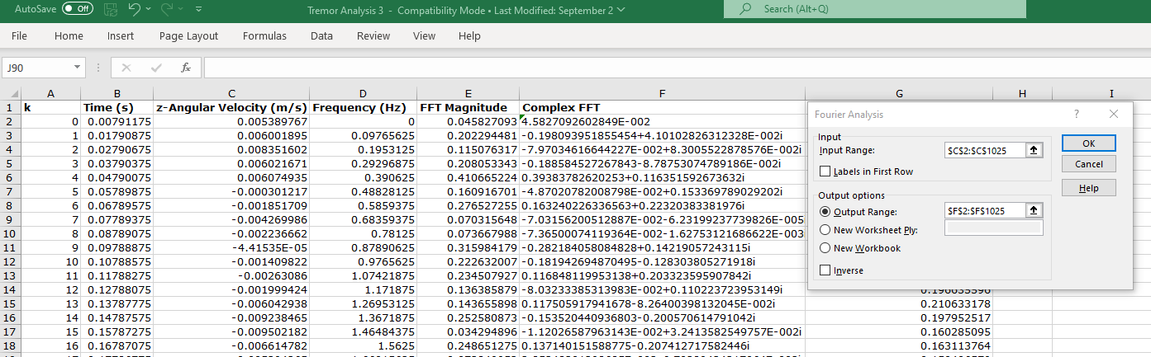
Time Domain → Frequency Domain
Conducting FFT using Analysis Tools in MS Excel
3) Select input range, in this case the z-angular velocity data. The number of points must be a power of 2 (e.g., 64, 128, 256, 512, 1024…) for the FFT algorithm.
4) Select output range, in this case labeled Complex FFT with the same range.

Slide 14
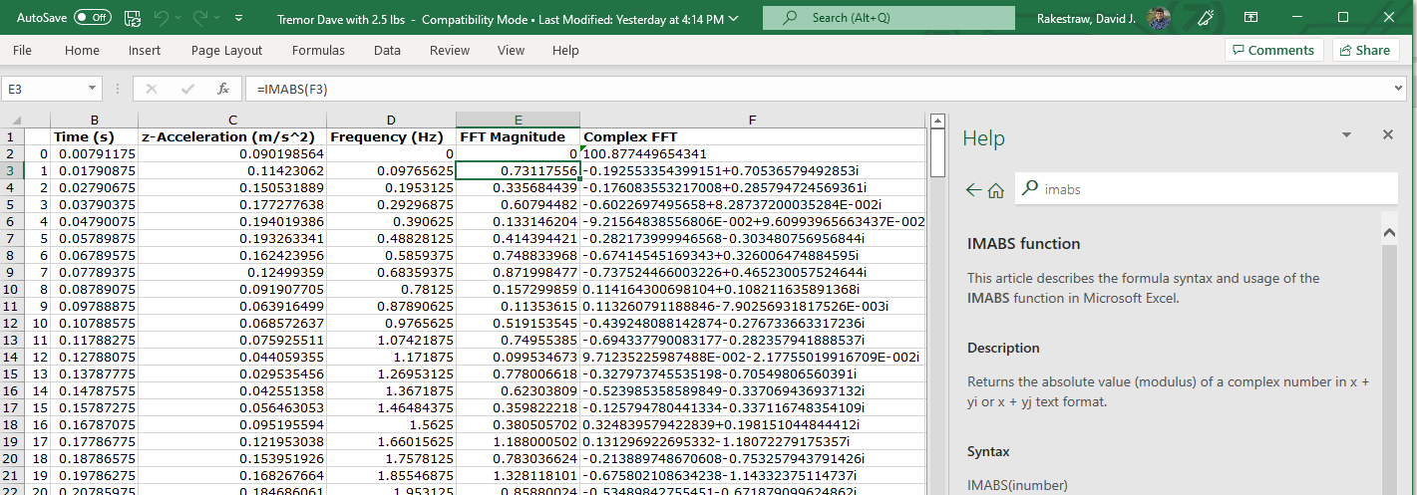
Time Domain → Frequency Domain
Conducting FFT using Analysis Tools in MS Excel
5) Use the IMABS function to return the absolute magnitude of the complex number produced by the FFT.

Slide 15
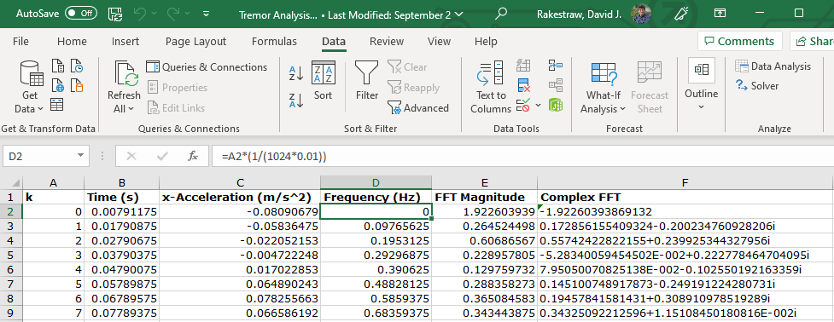
Time Domain → Frequency Domain
Conducting FFT using Analysis Tools in MS Excel
6) Generate a column for the frequency that uses the total number of data points in the analysis (in this case 1024) and the time interval between each data point (in this case 0.01 s).
7) Graph the data recognizing that only the data for frequencies that are one-half of the sampling frequency are unique (in this case, 50 Hz since the sampling rate was 100 Hz).
Notes:
A column with an index value, k, was created in column A to use in calculating the Frequency column.

Slide 16
z-Axis Acceleration
Frequency Domain—FFT in Excel
~7.0 Hz
Notes:
This is the result of the analysis which shows a clear resonance at ~7 Hz.
It is a little noisy and can be smoothed by using a simple moving average.

Slide 17
z-Axis Acceleration
Frequency Domain—FFT in Excel—Averaged Data
7.2 Hz
5 point moving average
The data on the previous graph has a frequency resolution of 0.1Hz which is more accurate than necessary for our purposes. The noise on the signal can be reduced and the signal to noise improved by conducting a simple moving average.
Notes:
This is the result of conducting a 5-point moving average. This can be done easily using the “data analysis” functions. The frequency domain graphs on the following slides will all take advantage of a 5-point moving average.
The average value was determined visually.

Slide 18
y-Axis Acceleration
Time Domain
Standard Deviation = 0.044 m/s²

Slide 19
y-Axis Acceleration
Frequency Domain
7.2 Hz
5 point moving average

Slide 20
x-Axis Acceleration
Time Domain
Standard Deviation = 0.052 m/s²

Slide 21
x-Axis Acceleration
Frequency Domain
Notes:
There clearly some resonances visible in the frequency power spectrum but the features are not as prominent as since for the other two axes. An attempt to determine a representative frequency was not attempted.

Slide 22

Summary of Acceleration Measurements
Axis | Acceleration Standard Deviation (m/s²) | Primary Oscillation Frequency (Hz)
x | 0.052 | -
y | 0.044 | 7.2
z | 0.088 | 7.2
+z
+x
+y
Notes:
Summary of the analysis of the acceleration measurements on all three axes.
It appears that the largest movement occurs along the z-axis, which is also the direction in which the wrist has the largest potential displacement.
The primary oscillation frequency was determined to be 7.2 Hz.

Slide 23
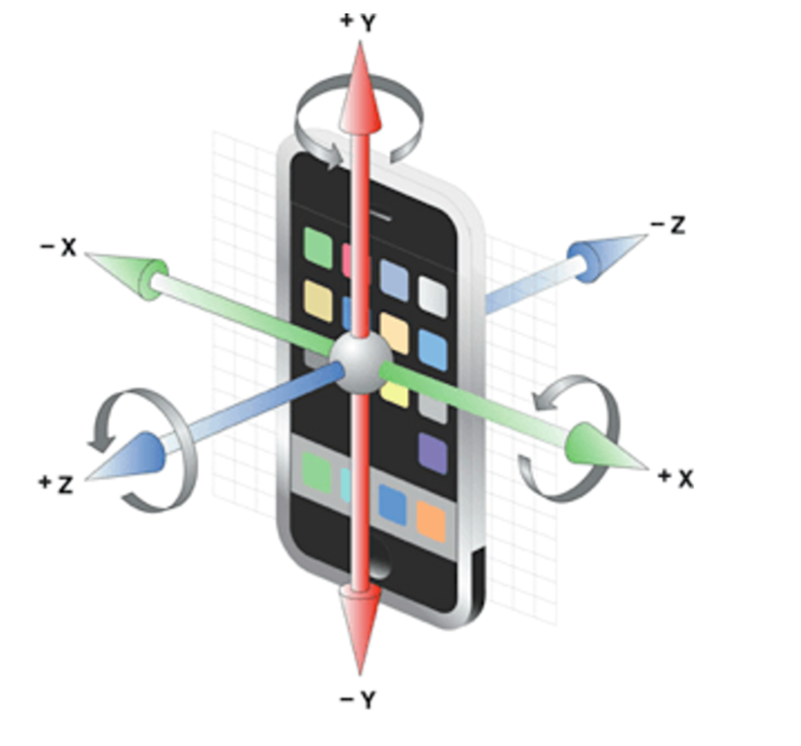
Next: Angular Velocity

Slide 24
x-Axis Angular Velocity
Time Domain
Standard Deviation = 0.014 rad/s
Notes:
The x-axis angular velocity demonstrated the most visual oscillatory pattern.

Slide 25
x-Axis Angular Velocity
Frequency Domain
5 point moving average
7.1 Hz

Slide 26
y-Axis Angular Velocity
Time Domain
Standard Deviation = 0.018 rad/s
Notes:
The occasional large change in angular velocity was an interesting feature of y-axis data. It would be interesting to better understand the origin. Such large deviations in the y-axis angular velocity were regularly observed to be more likely than such features along other axes when looking over many data sets.

Slide 27
y-Axis Angular Velocity
Frequency Domain
5 point moving average
Notes:
No clear resonance frequency was visible.

Slide 28
z-Axis Angular Velocity
Time Domain
Standard Deviation = 0.0085 rad/s

Slide 29
z-Axis Angular Velocity
Frequency Domain
5 point moving average
Notes:
There appear to be two potential resonances in this data at 7.4 Hz and 13.5 Hz. Further investigation would be needed to evaluate the consistent observation of these resonances.

Slide 30
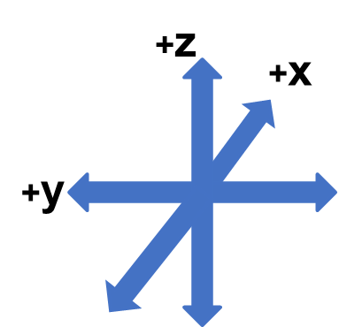
Summary of Angular Velocity Measurements
Axis | Angular Velocity Standard Deviation (m/s) | Primary Oscillation Frequency (Hz)
x | 0.014 | 7.1
y | 0.018 | -
z | 0.009 | -

Slide 31
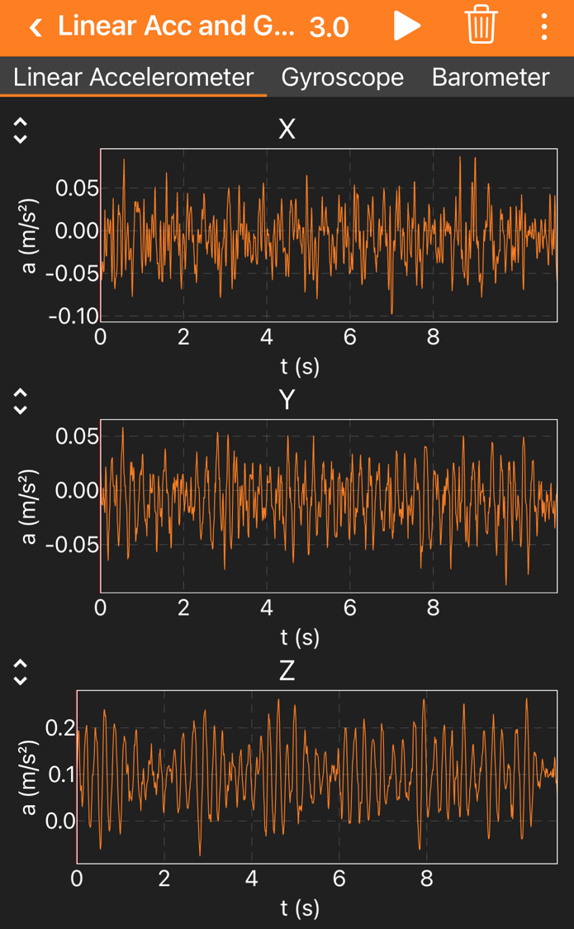
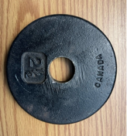
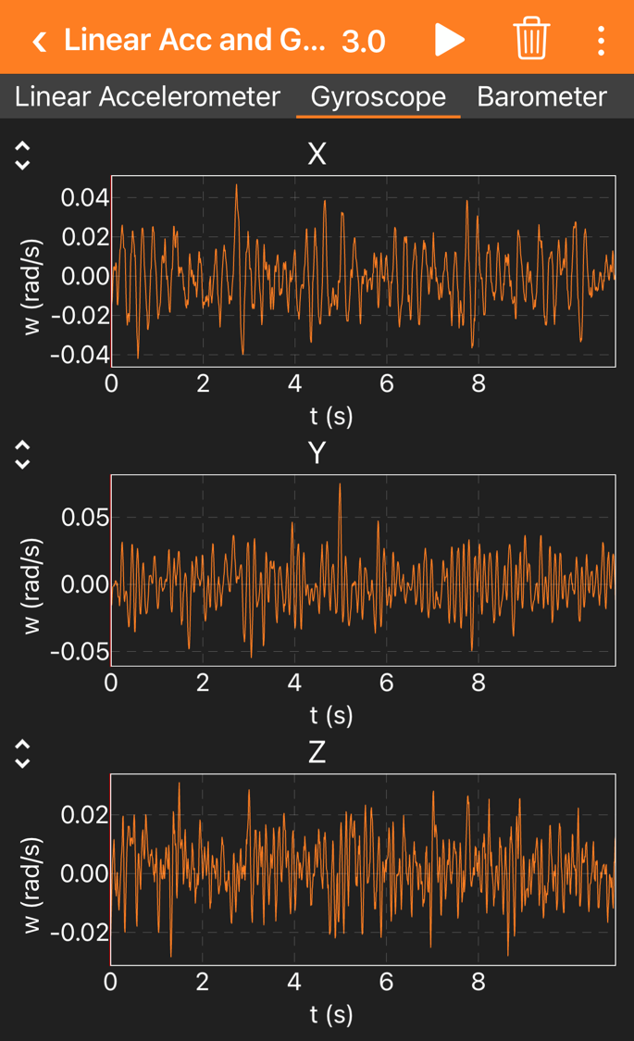
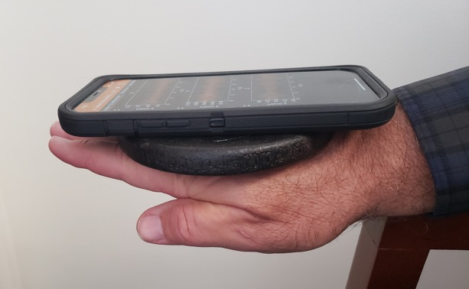

Influence of Mass on Tremor Frequency
2.5 lbs.
Hypothesis
Physiologic tremors are governed by the inertial and elastic properties of the body. Model would predict:
$$frequency ∝\sqrt{\frac{1}{mass}}$$
Notes:
Example data collected with an iPhone 12 Pro Max in a case.
The forearm was placed on the armrest of a chair so that the arm was completely relaxed as in previous experiment. A 2.5 lbs. mass was place on the hand and the phone was placed on top of the mass.
Data was collected for 11 seconds to assure that >1024 points were available for the FFT analysis.

Slide 32
x-Axis Angular Velocity
Time Domain

Slide 33
x-Axis Angular Velocity
Frequency Domain
5 point moving average
4.6 Hz

Slide 34

x-Axis Angular Velocity
Comparing frequency of tremors for unload and loaded (+2.5 lbs.) hand
4.8 Hz
7.4 Hz
$$frequency ∝\sqrt{\frac{1}{mass}}$$
10 point moving average
Notes:
The frequency of the physiologic tremor shifts by more than 30% to a lower frequency. A similar shift was observed in the acceleration measurements. This shift is well documented in the scientific literature.
This provides a wonderful connection between a simple physics model (mass on a spring) to real-life applications in biomechanics.

Slide 35
Comparison of Two Subjects
y-axis Acceleration in Frequency Domain
Analysis of the frequency patterns can serve as a useful medical diagnostic by identifying tremors that might be associated with various medical conditions.
Notes:
A very clear mechanical reflex tremor with a well-defined oscillation frequency is observed in subject 2. A more complicated tremor pattern which likely involves more neurological components that do not shift frequency with added mass are observed in subject 1.

Slide 36
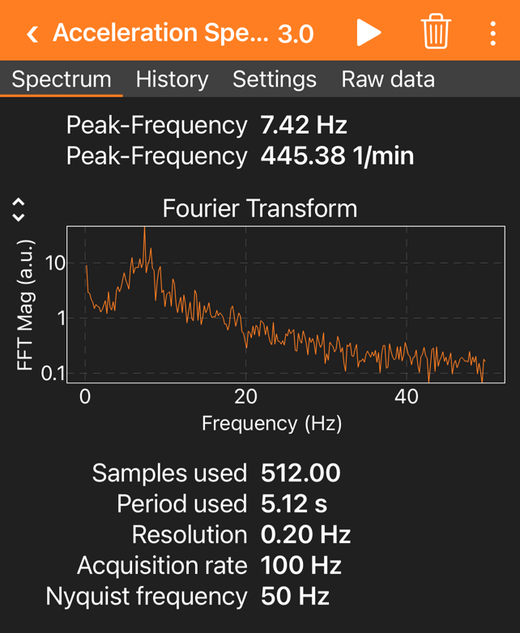
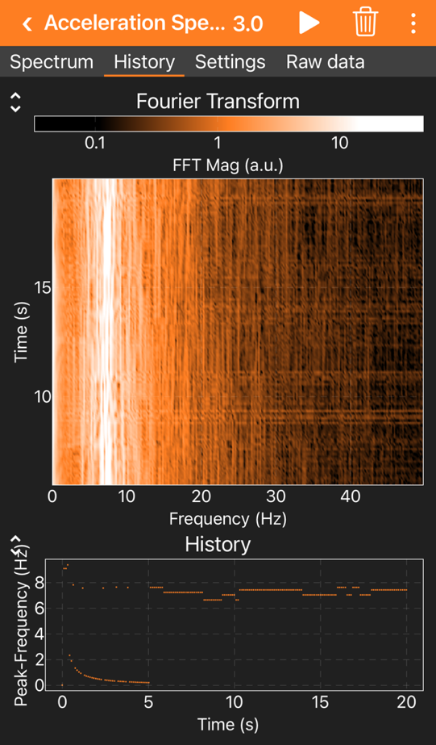
Analysis of Physiologic Tremors with “Acceleration Spectrum” Module
Phyphox has a “tool” to calculate the frequency domain information from acceleration
The “Spectrum” display updates continuously during the experiment
The “History” display provides a waterfall plot. It provides a very visible illustration of the primary oscillation frequency of the tremor.

Slide 37
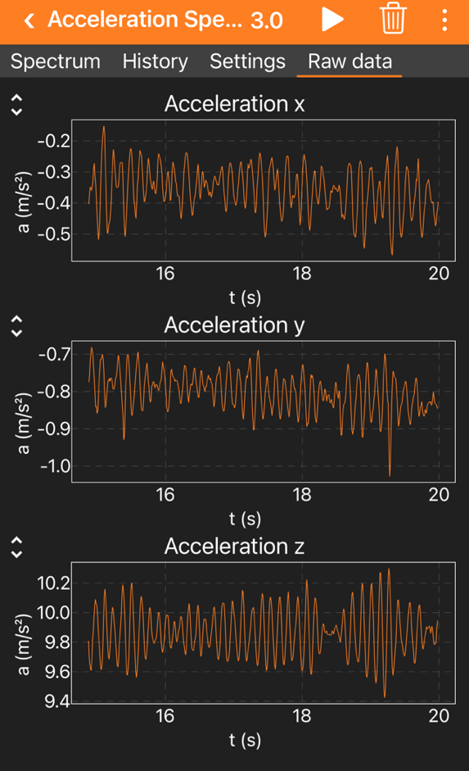
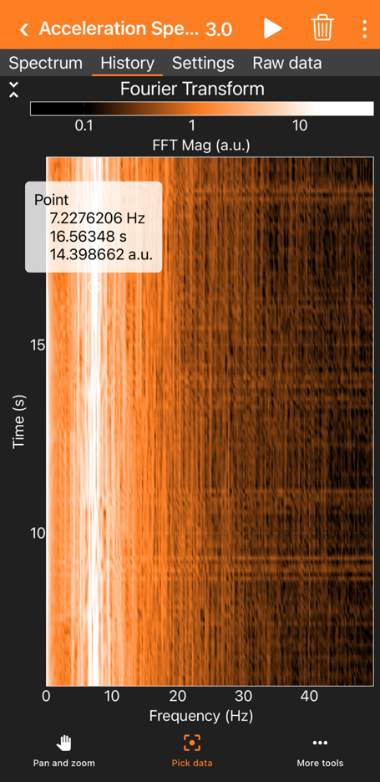
Analysis of Physiologic Tremors with Acceleration Spectrum Module
Phyphox can provide frequency domain information on absolute acceleration
Acceleration data used in the analysis.
“Pick data” used to determine the primary tremor frequency.

Slide 38
These sensors and the associated tools provide the opportunity for students to investigate the vibrational frequencies in household equipment and potentially identify the origin. A few examples follow.

Slide 39
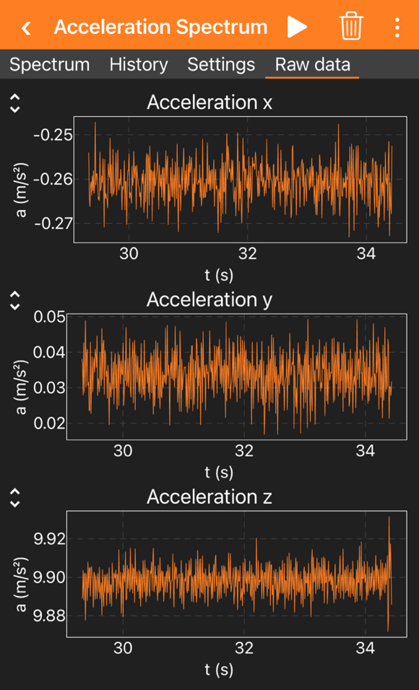
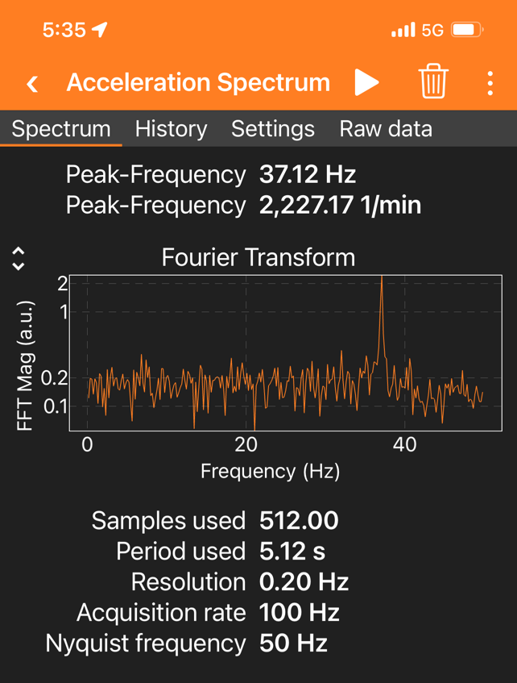
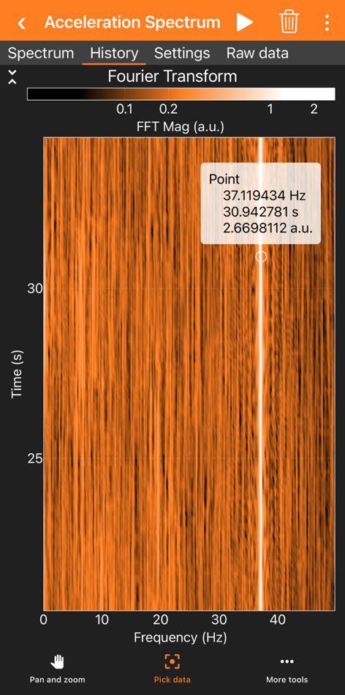
Measurement of Vibrational Frequencies of Computer Case
Many devices have vibrations produced by objects spinning at constant angular velocities
Notes:
This data was taken by setting the phone on the case of a small computer. When the same measurement was made with an Android phone with higher data collection rates, additional higher frequencies were observed.
Students can explore a variety of different appliances and see what they can observe.

Slide 40
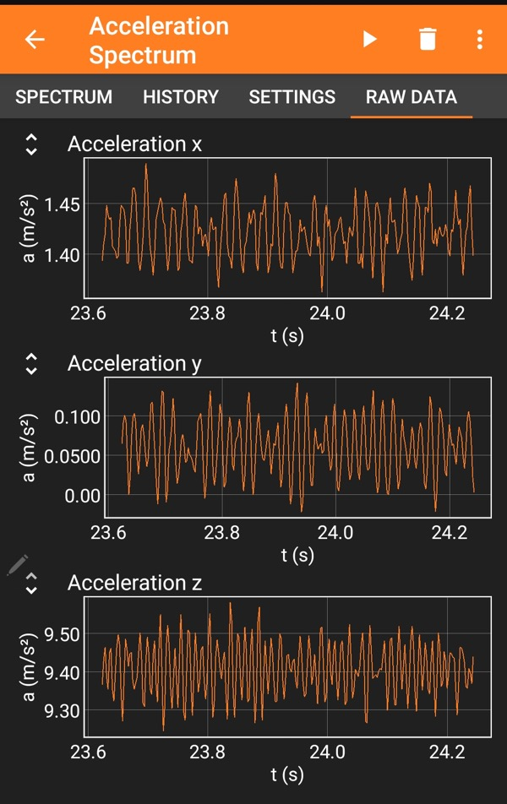
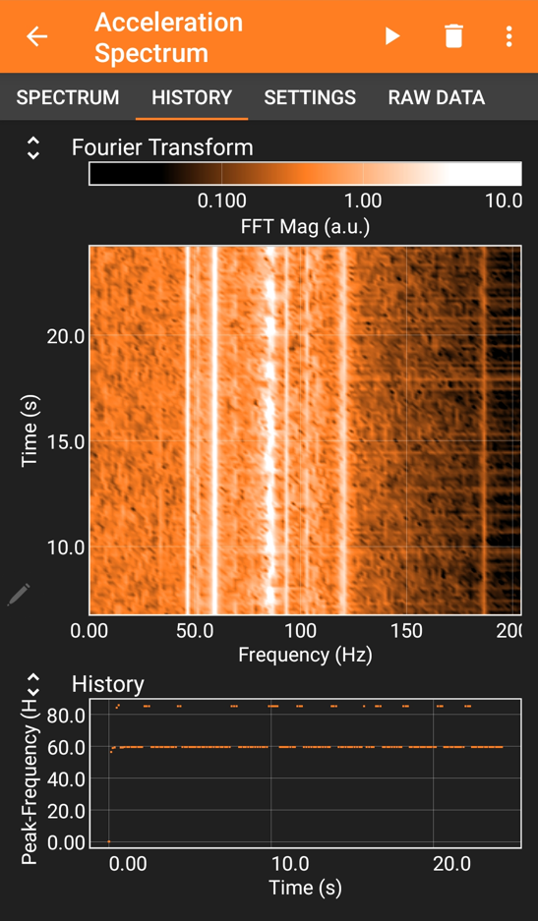
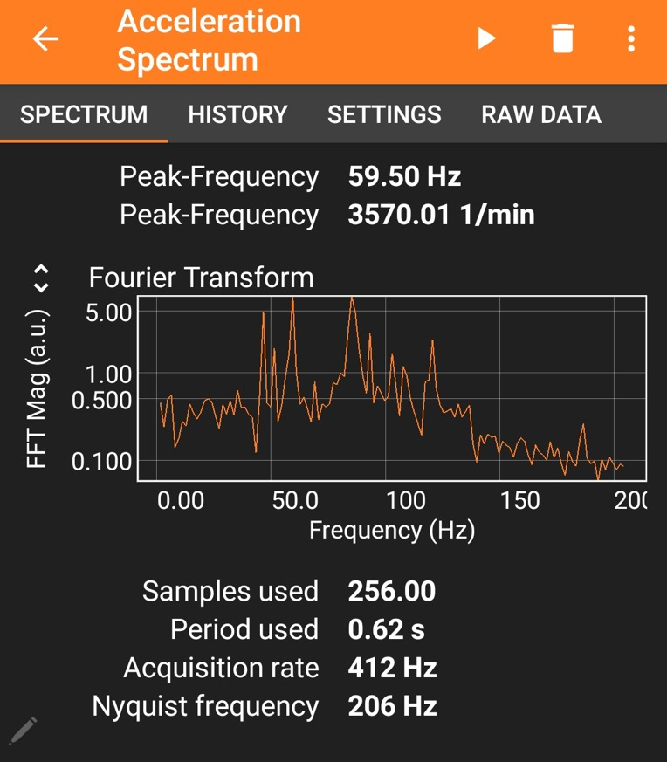
Measurement of Vibrational Frequencies of Refrigerator
Many different frequencies are measured
Notes:
This data was taken by setting the phone on the case of a small computer. When the same measurement was made with an Android phone with higher data collection rates, additional higher frequencies were observed.
Students can explore a variety of different appliances and see what they can observe.

Slide 41

Experiment 11
Stability Contest

Slide 42
Experiment 11
Stability Contest
  Have students design a contest where the gyroscope is used to measure stability. (Consider having students develop ideas for the contest as homework and vote on the idea that will be used in the experiment.) Ideas might include:
    Holding phone in hand with eyes open and/or with eyes closed
    Picking up the phone from a table with certain constraints
    Walking with phone from point A to point B with or without time constrains
    Walking with phone for short distance with eyes open and/or closed
    Climbing up steps with phone
Criteria for stability could include the lowest high value of angular acceleration
measured or the students may want to determine other ways of evaluating “stability”
Notes:
This activity will encourage further exploration of the sensor properties at home.
It will also make students think about how best to characterize the data for “stability.” Averages vs. single point fluctuations. Data will show how different criteria may produce different “winners.”

Slide 43
How Inertia Measurement Units are Changing Our Lives in Unexpected Ways

Slide 44
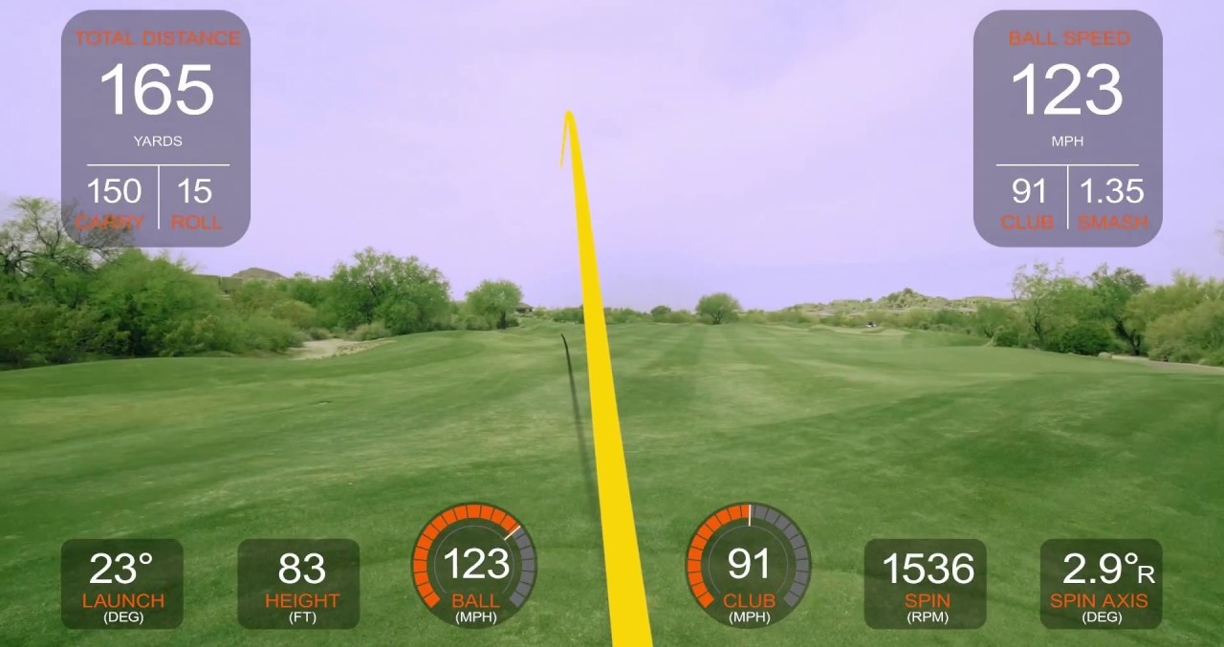
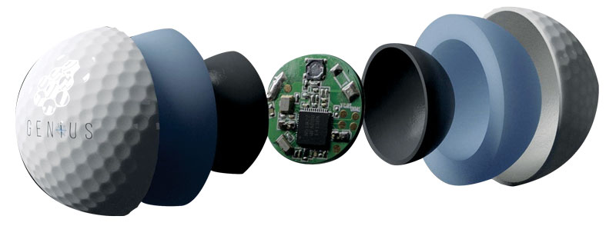
Imbedded accelerometers, gyroscopes, and magnetometers
are allowing sports enthusiasts to analyze their games with remarkable detail
Notes:
The combination of accelerometer, gyroscope, and magnetometer sensors enables the measurement of many very important parameters for the golfer.

Slide 45
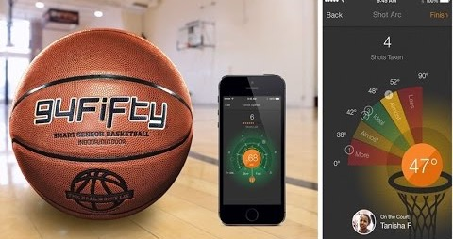

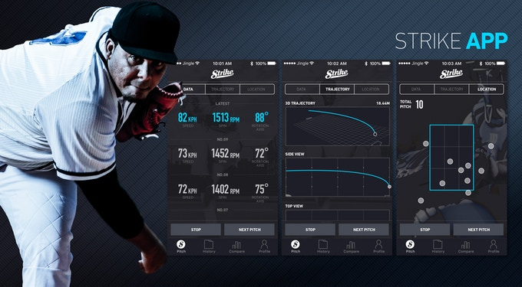
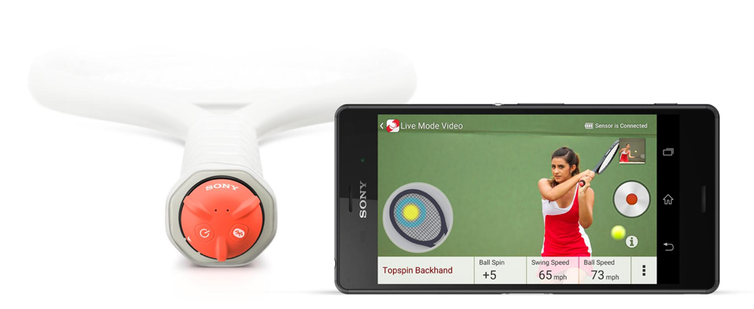

Notes:
Entrepreneurs have taken advantage of the sensors to create products for many different sports enthusiasts.

Slide 46
Design and operational principles
of a MEMS gyroscope

Slide 47
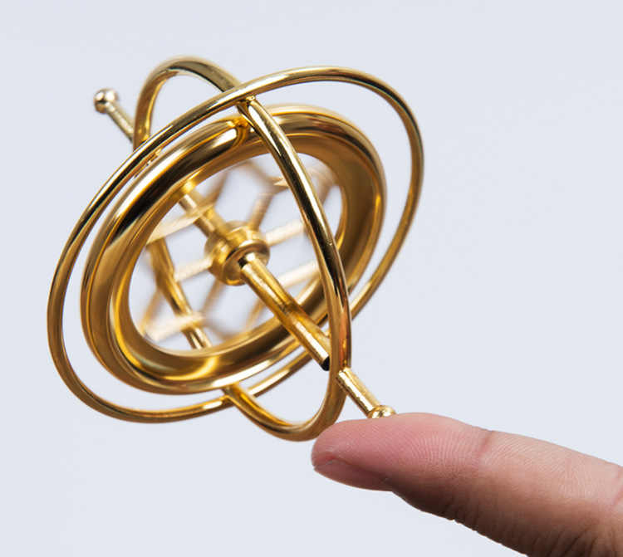
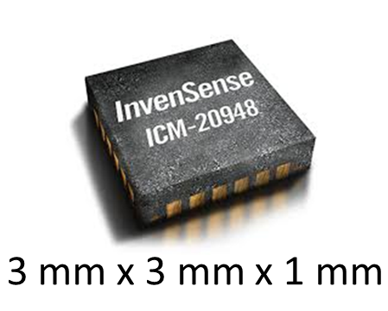
How Does a Microelectromechanical System (MEMS)
Gyroscope Work?
Hard to fit a traditional gyroscope in this small package.

Slide 48
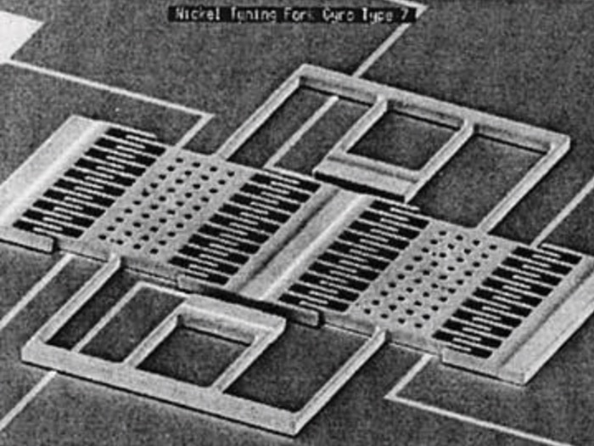
Scanning Electron Microscope Image of MEMS Gyroscope
First “tuning fork” MEMS gyroscope built by Draper Labs in 1993
Dimensions:
0.7 mm x 0.7 mm
Significant R&D has improved the design and performance of the MEMS gyroscopes over the years
Notes:
The MEMs sensors are based on the Coriolis effect. The basic explanation of how the sensors work are covered in the next few slides.

Slide 49
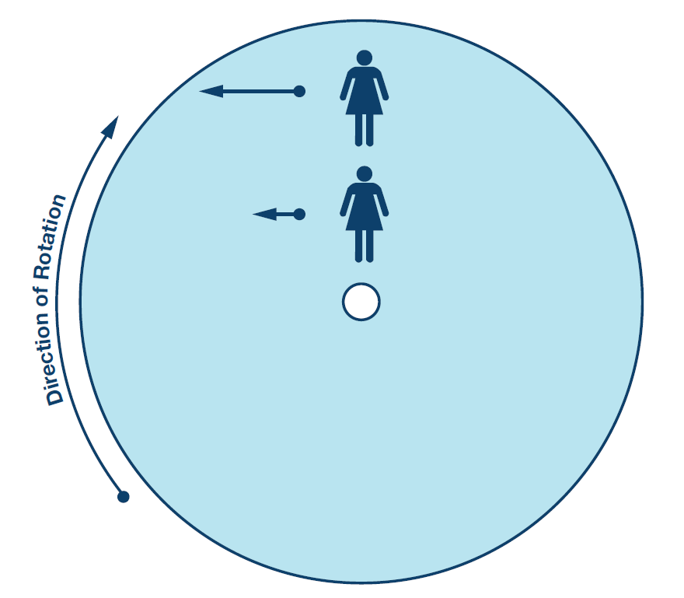
Coriolis Effect
As a person moves northward toward the outer edge of the rotating platform, they must increase the westward speed to maintain a northbound course.
The acceleration required is the Coriolis acceleration.

Slide 50
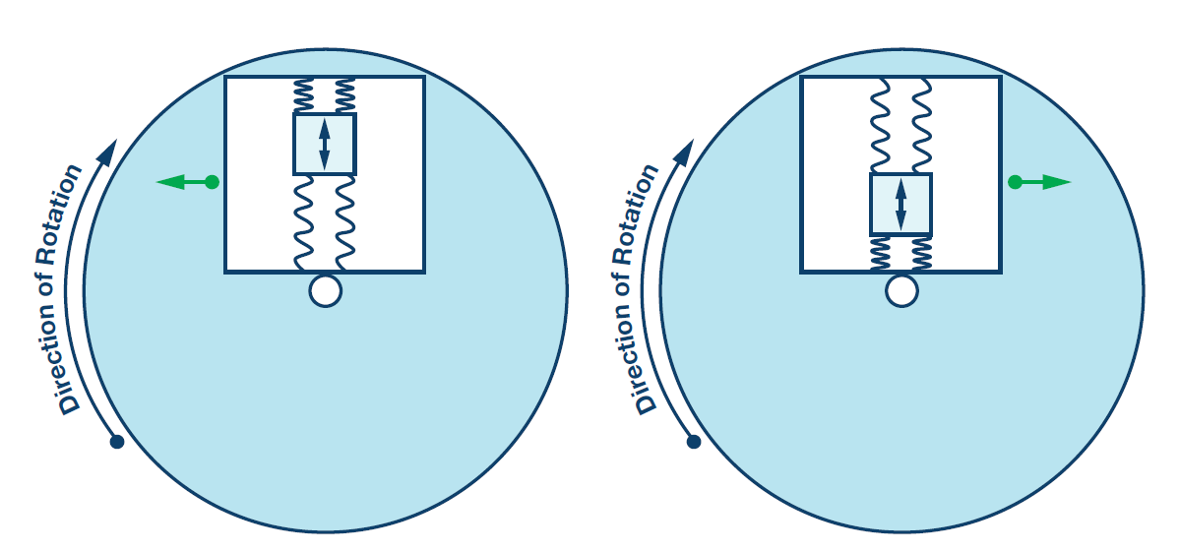
Concept for MEMS Gyroscope
The Coriolis effect will result in a perceived change in force on a vibrating mass that will be proportional to the rate of rotation.

Slide 51
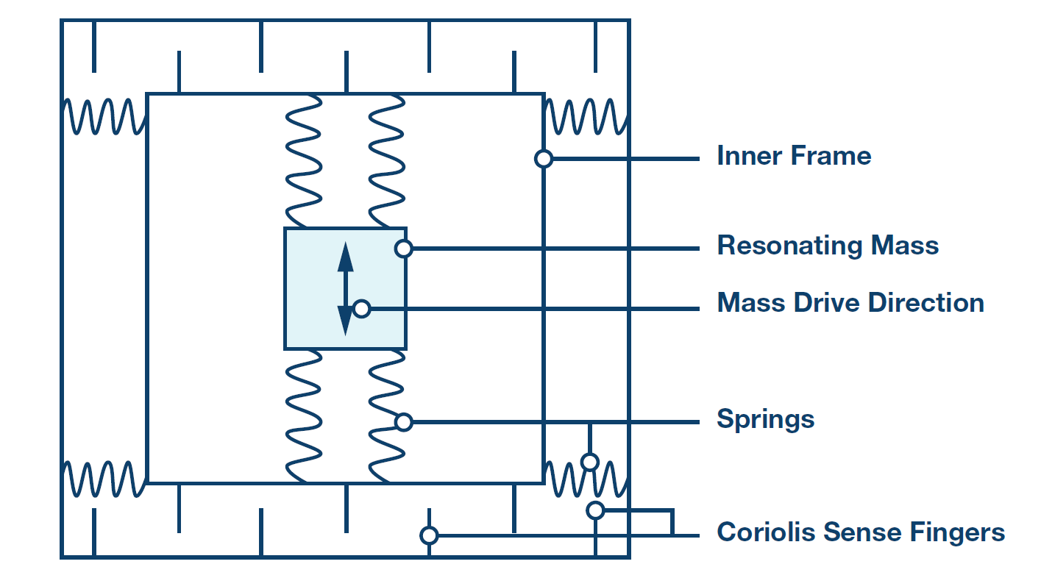
Concept for MEMS Gyroscope
An oscillating mass is attached to a frame. Movement of the frame to the right or left will change the relative position of the “sense fingers” resulting in a change in capacitance that can be easily measured.

Slide 52
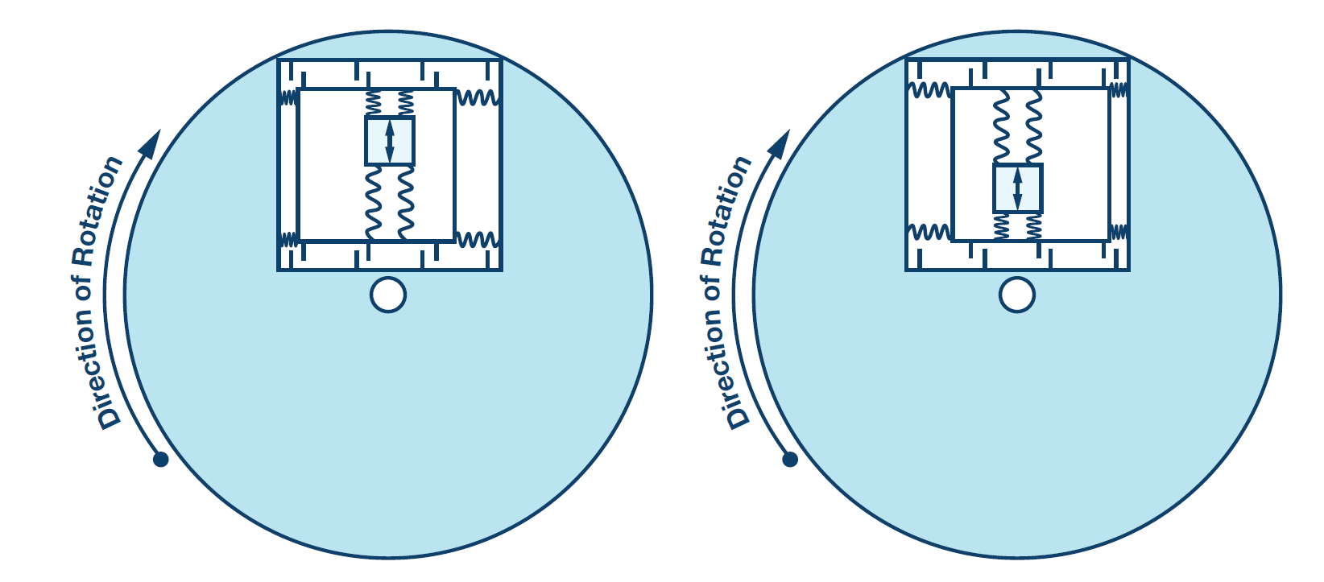
Concept for MEMS Gyroscope
The frame holding the vibrating mass will be displaced by the Coriolis effect and allow measurement of rotation = Gyroscope.

Slide 53
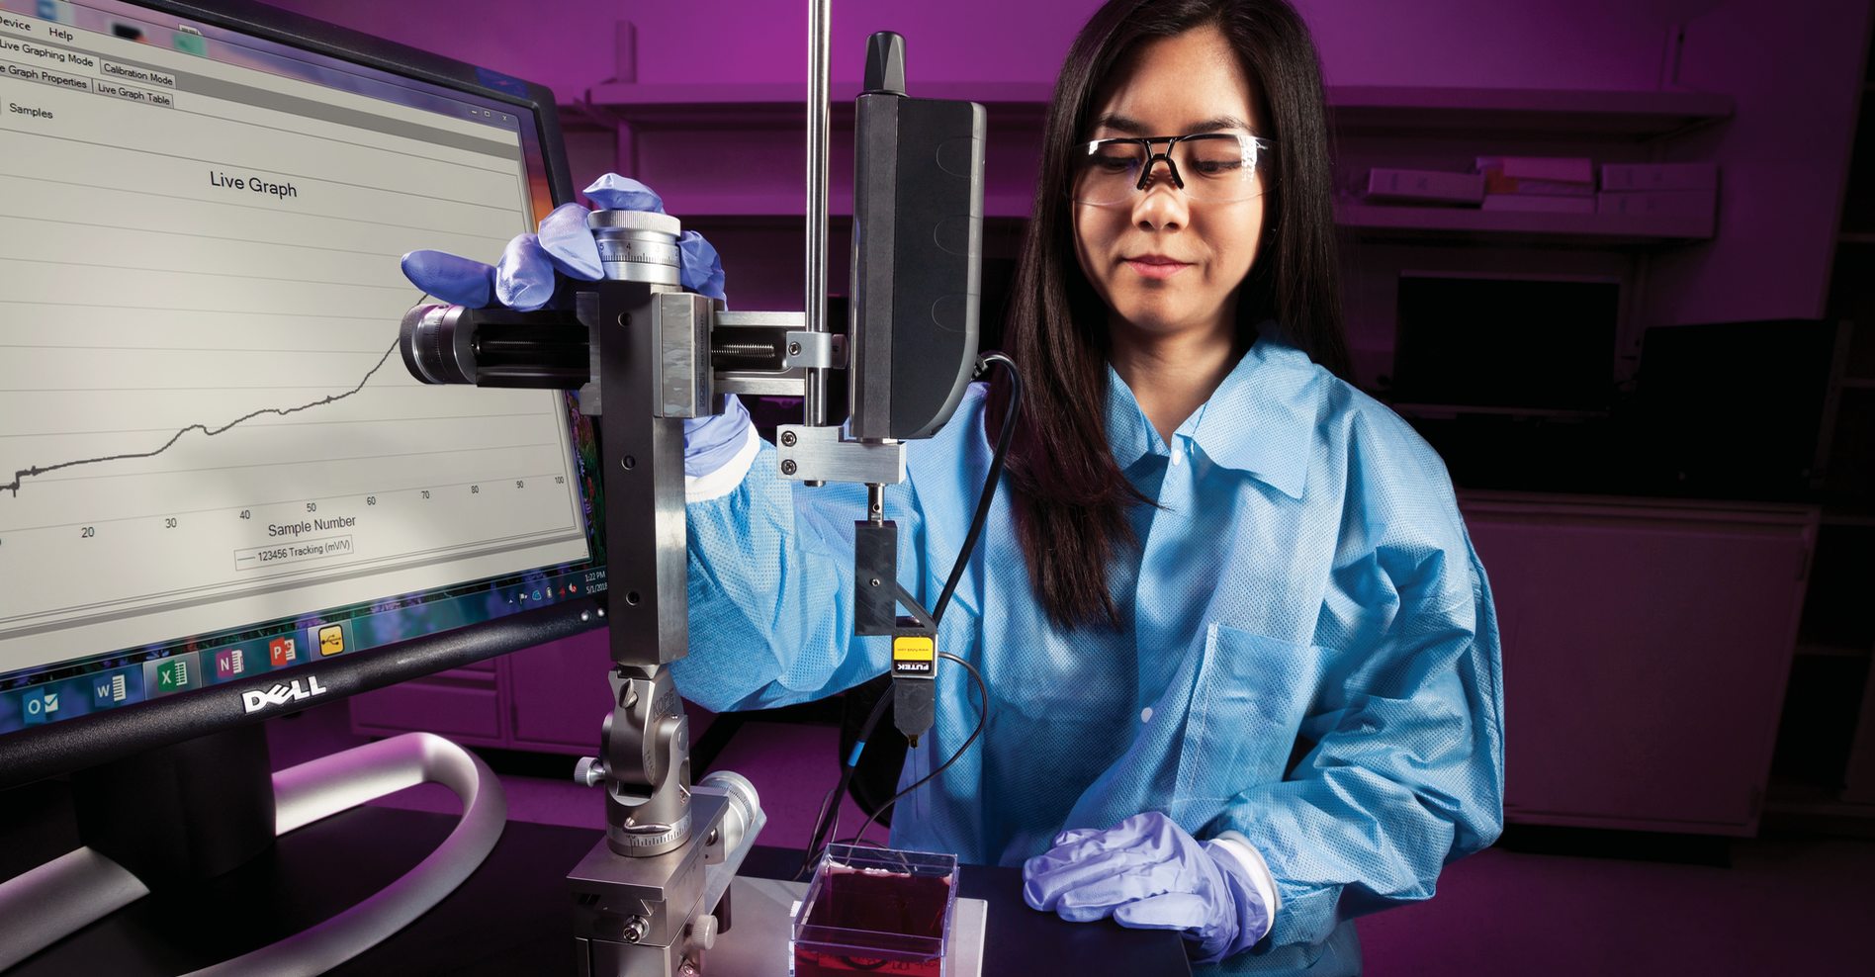
Let Me
Know
I welcome any feedback on errors you might find or ideas on how to improve this for students and teachers.
Prepared by:
David Rakestraw
Senior Scientist
Lawrence Livermore National Laboratory
rakestraw1@llnl.gov • 925-216-8106 • st.llnl.gov

Slide 54

This work was performed under the auspices of the U.S. Department of Energy by Lawrence Livermore National Laboratory under Contract DE-AC52-07NA27344.

